Slide 1
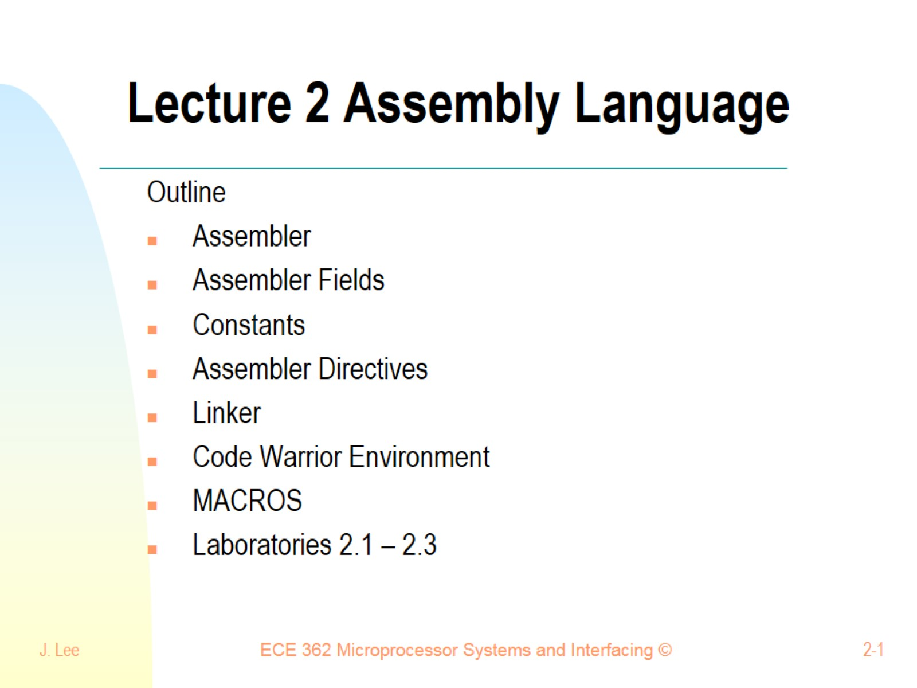
Lecture 2 Assembly Language

Slide 2
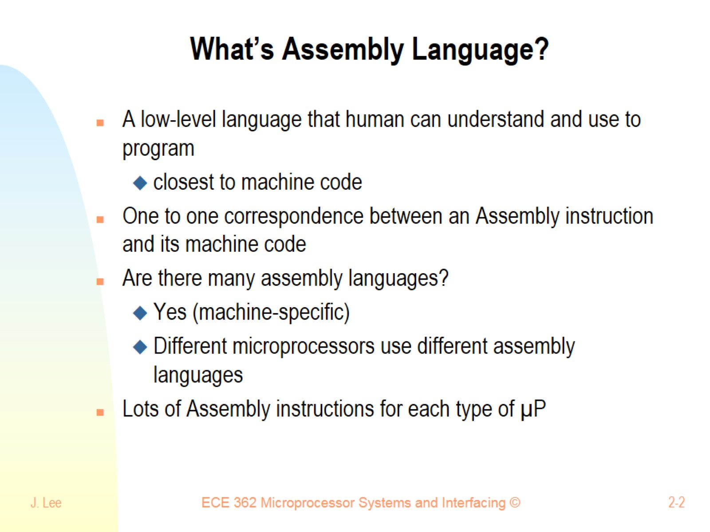
What’s Assembly Language?

Slide 3
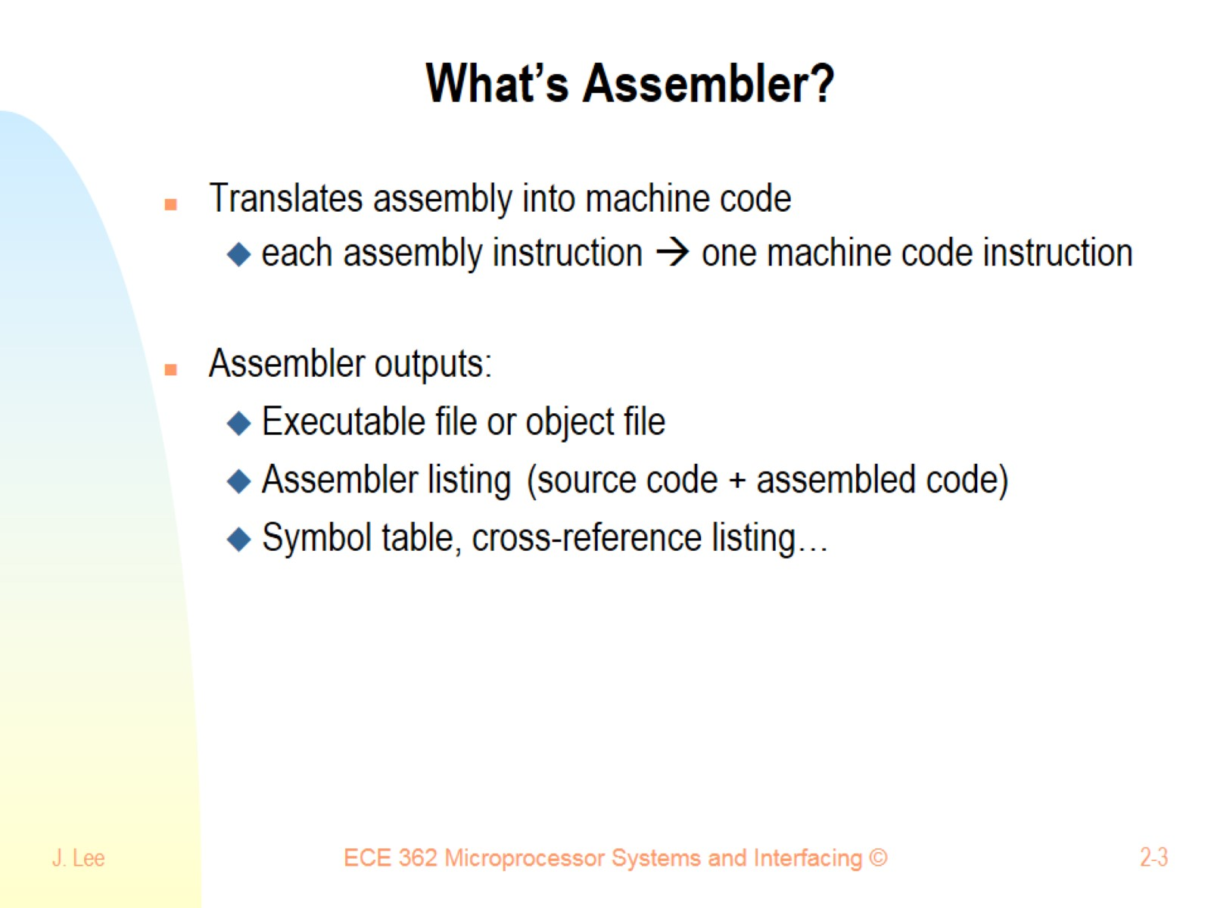
What’s Assembler?

Slide 4
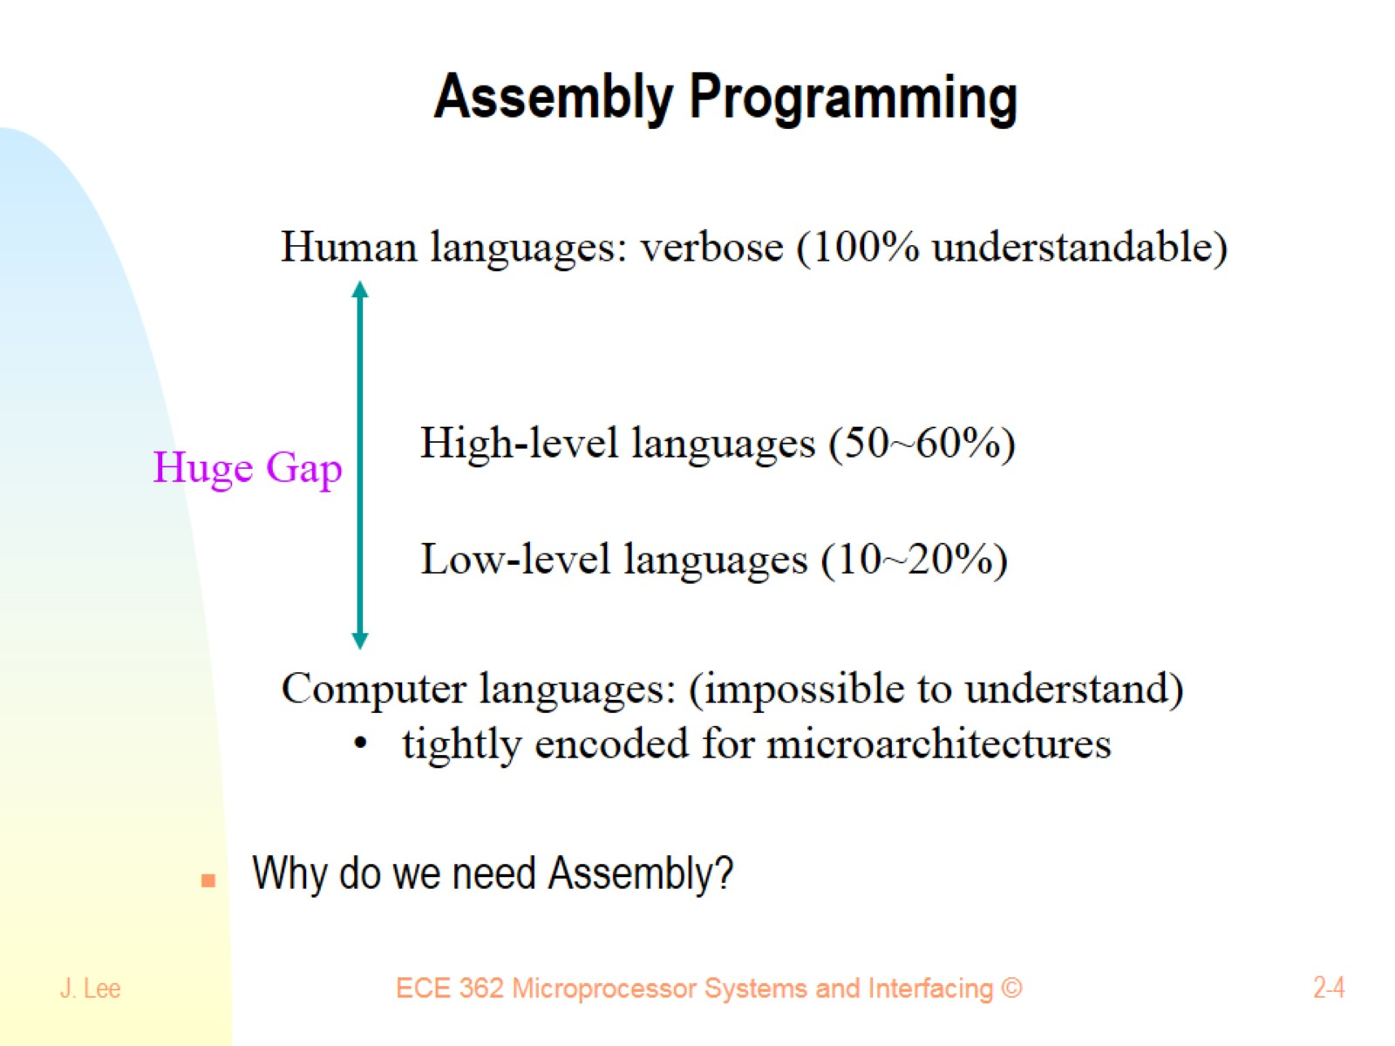
Assembly Programming

Slide 5
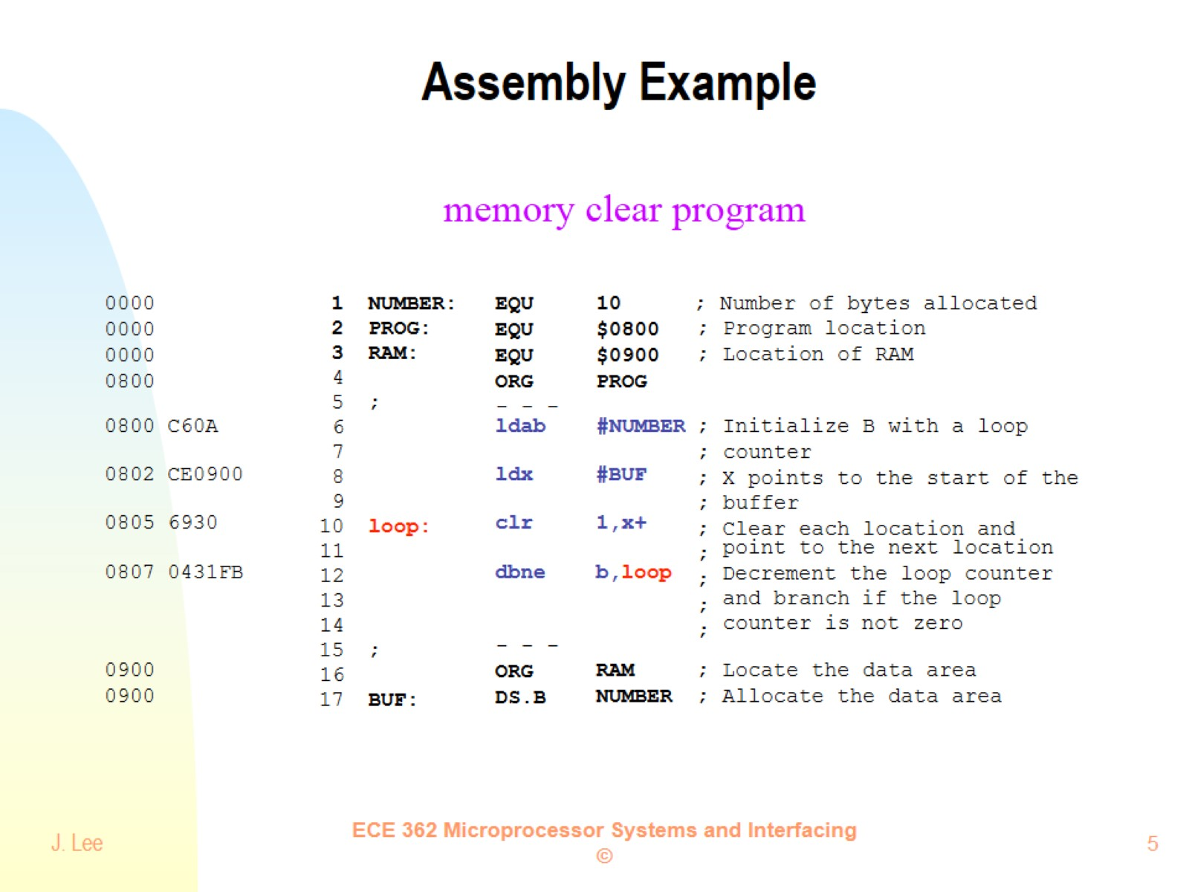
Assembly Example

Slide 6
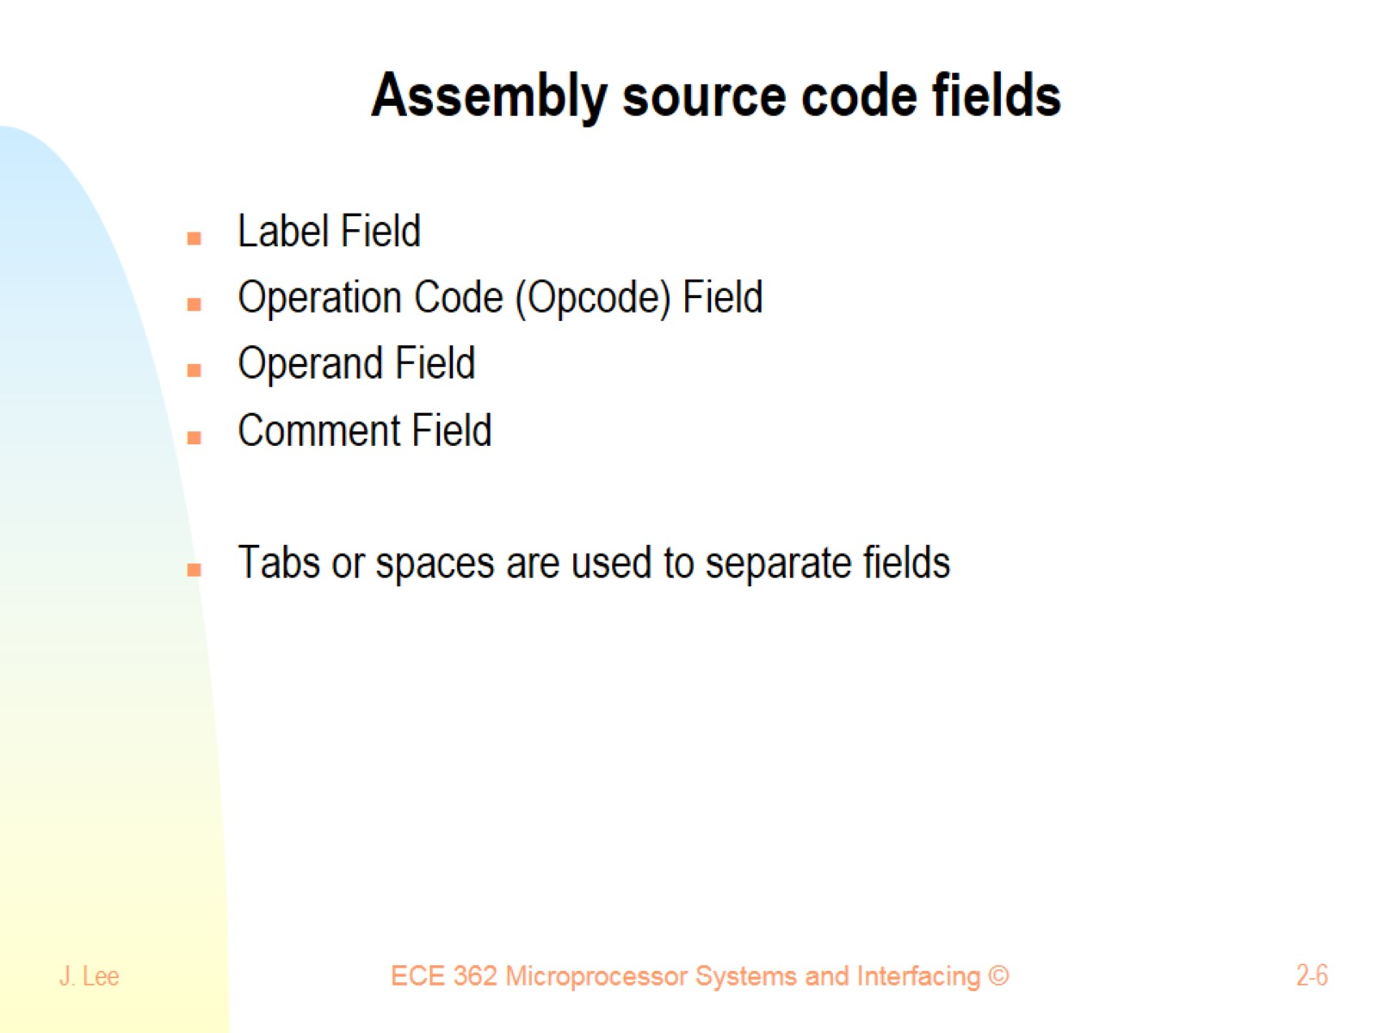
Assembly source code fields

Slide 7
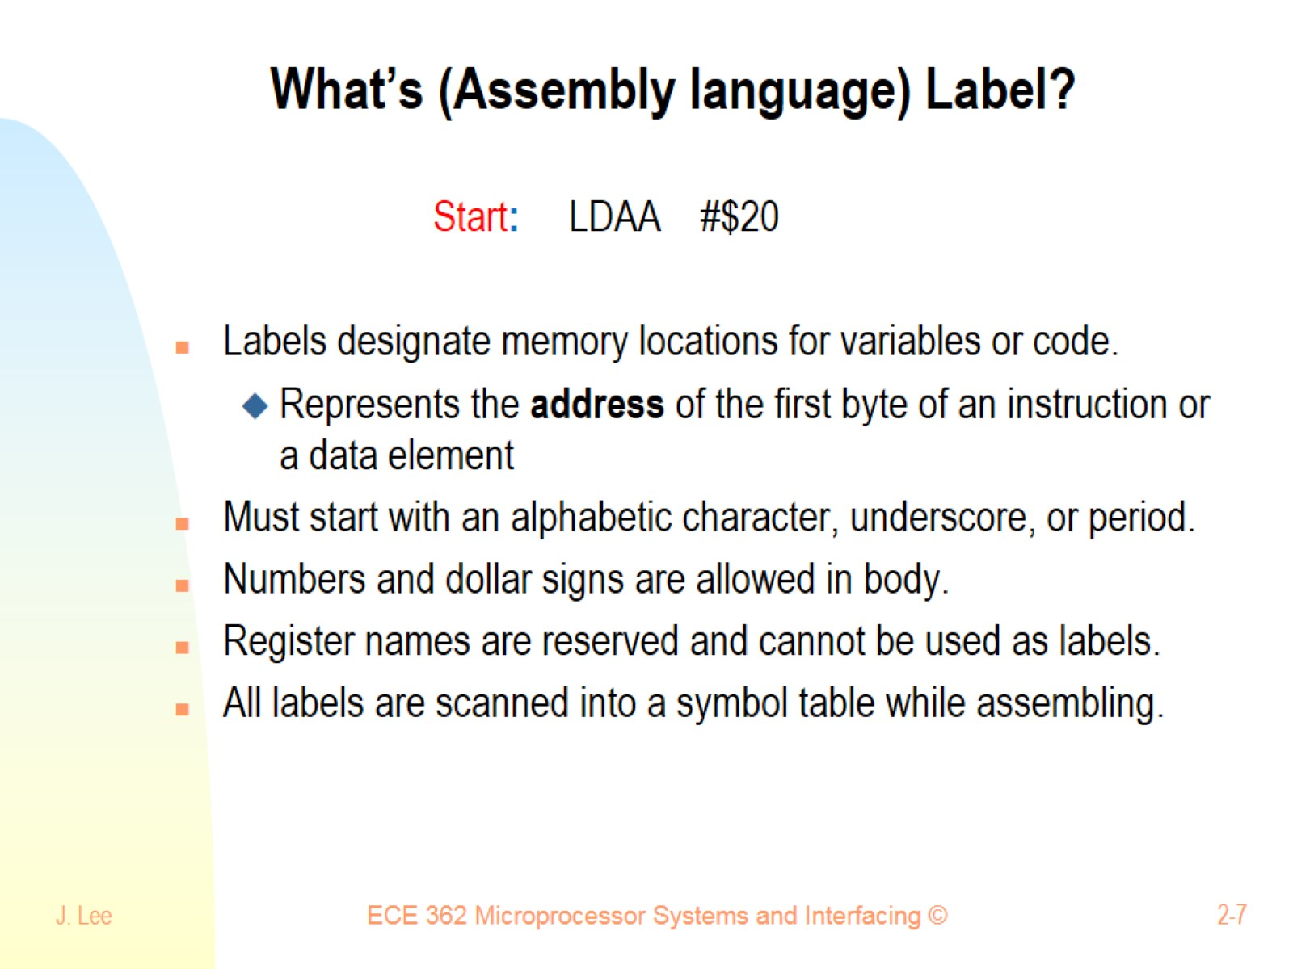
What’s (Assembly language) Label?

Slide 8
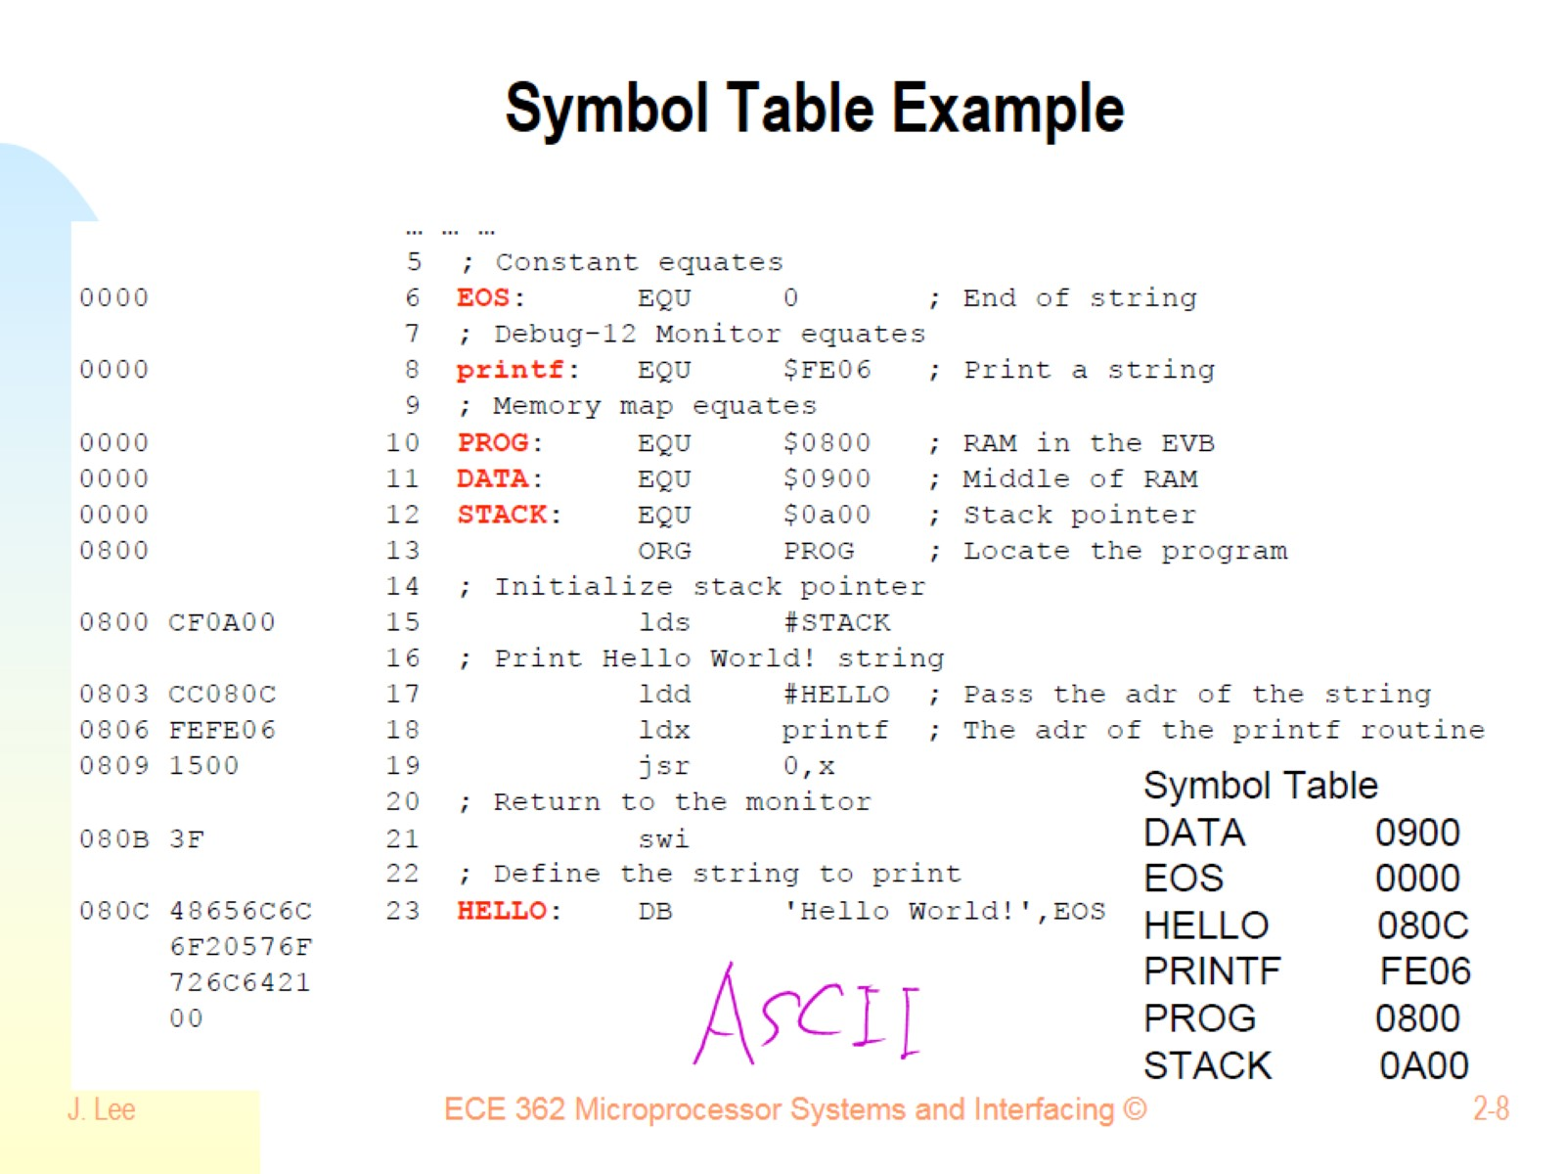
Symbol Table Example

Slide 9
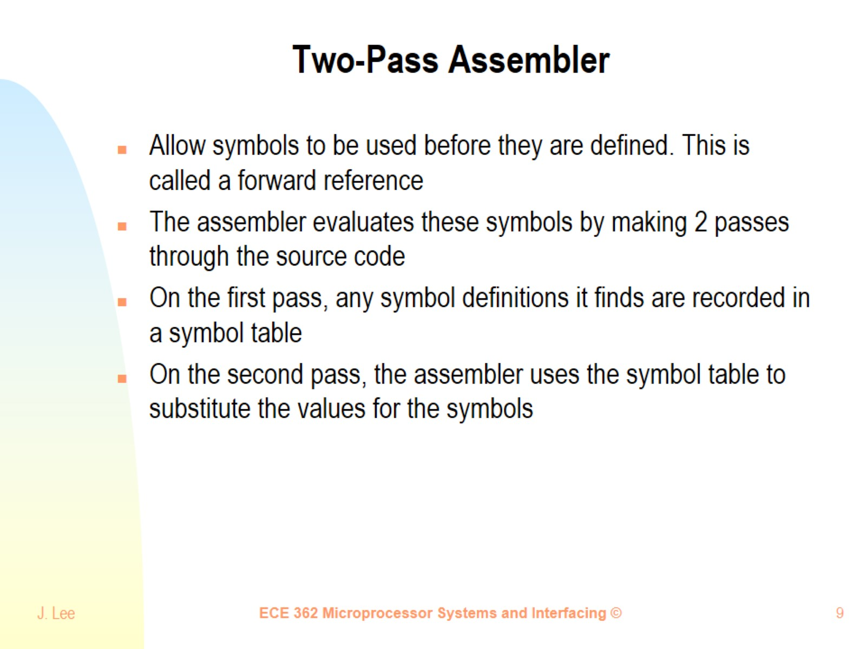
Two-Pass Assembler

Slide 10
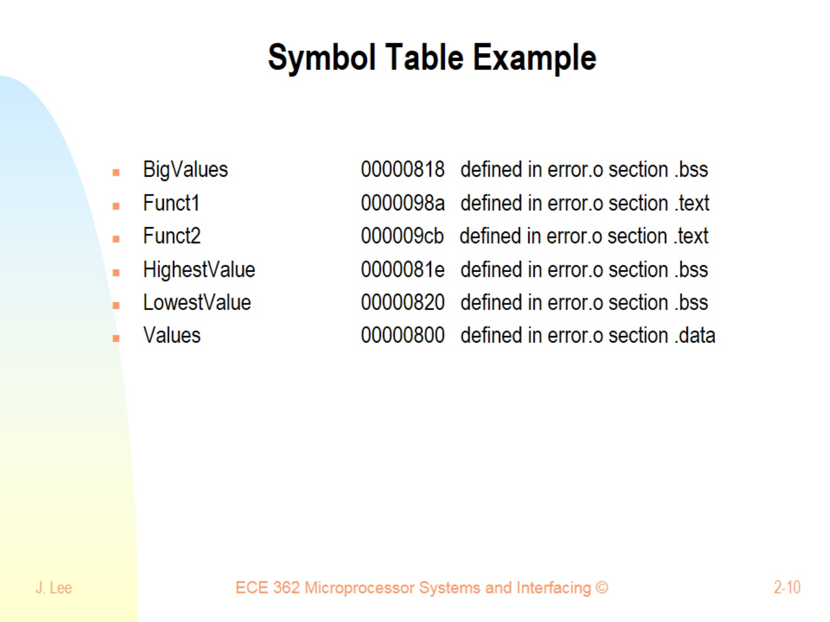
Symbol Table Example

Slide 11
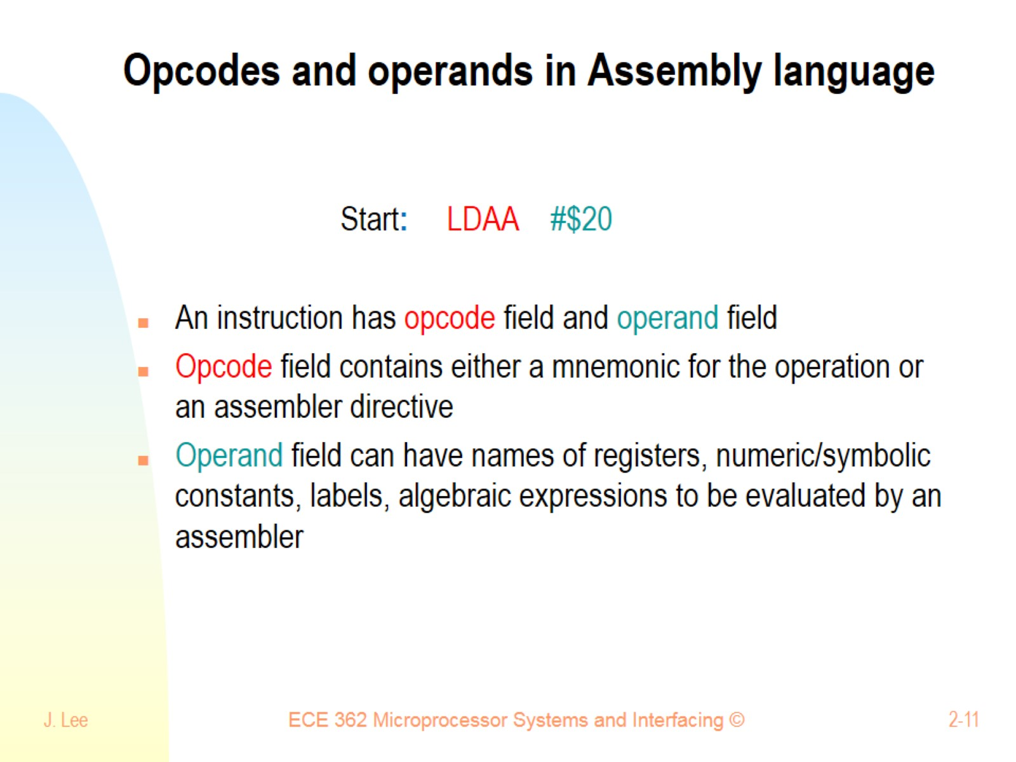
Opcodes and operands in Assembly language

Slide 12
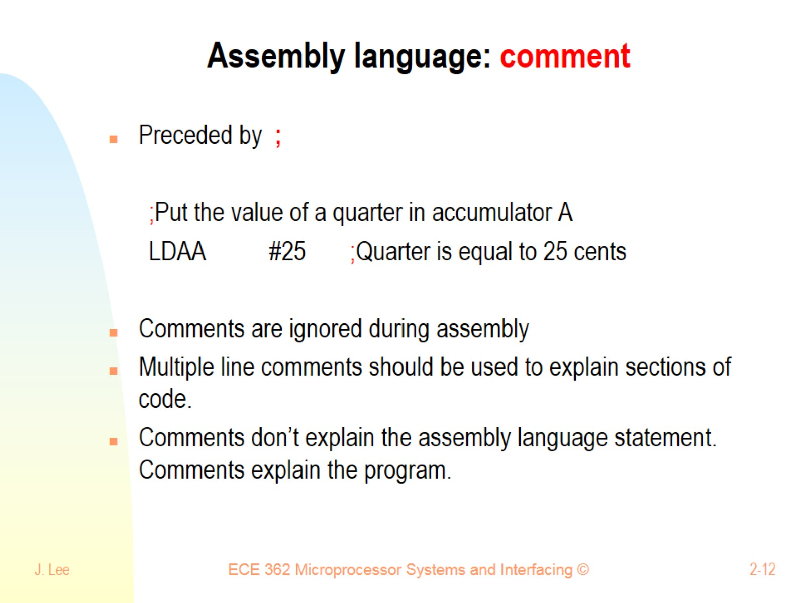
Assembly language: comment

Slide 13
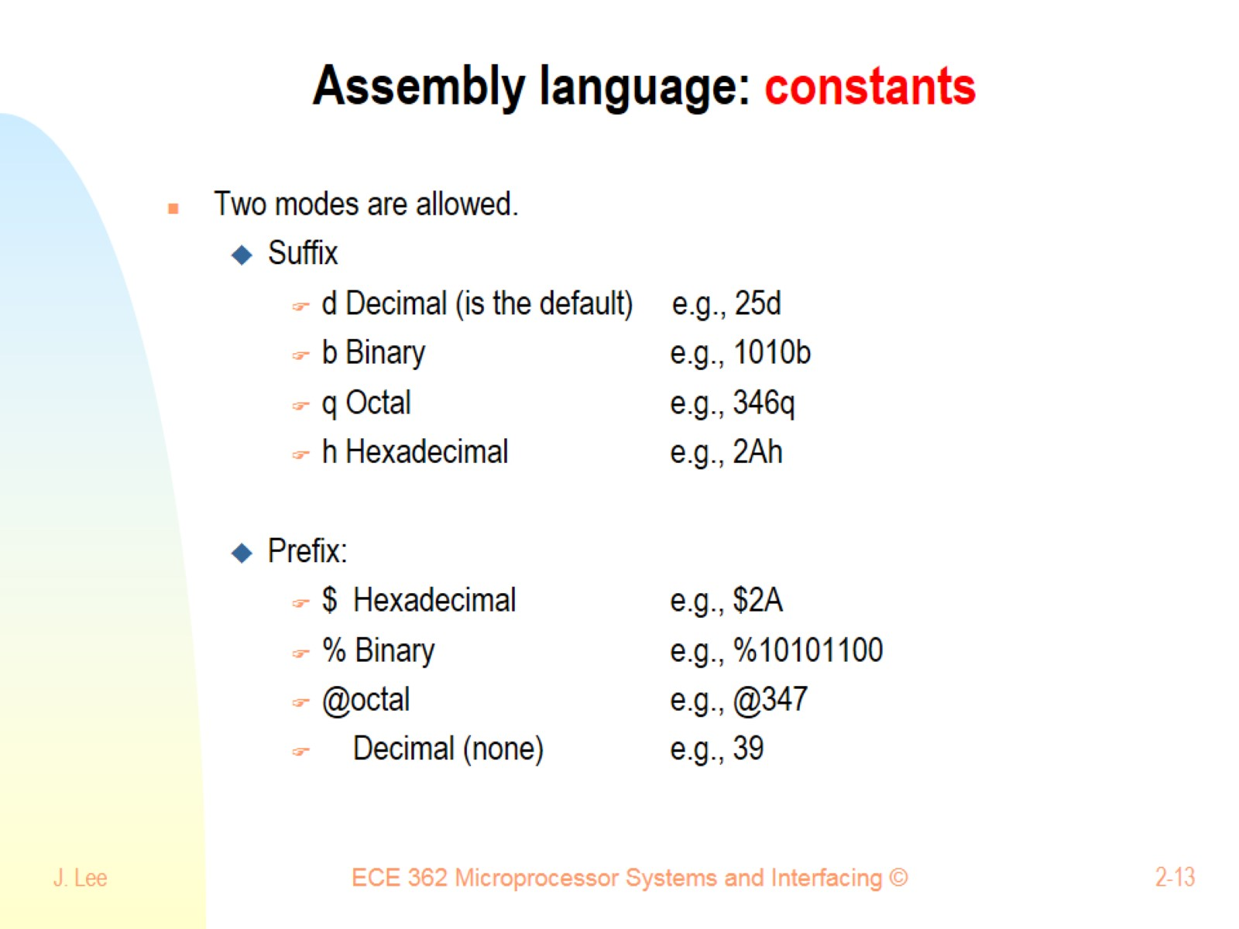
Assembly language: constants

Slide 14
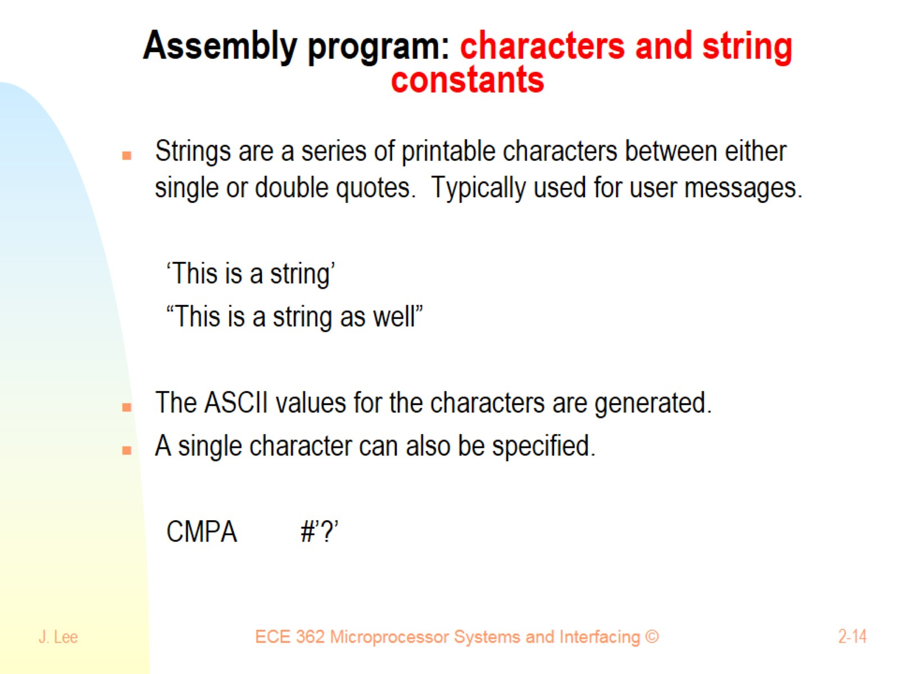
Assembly program: characters and string constants

Slide 15
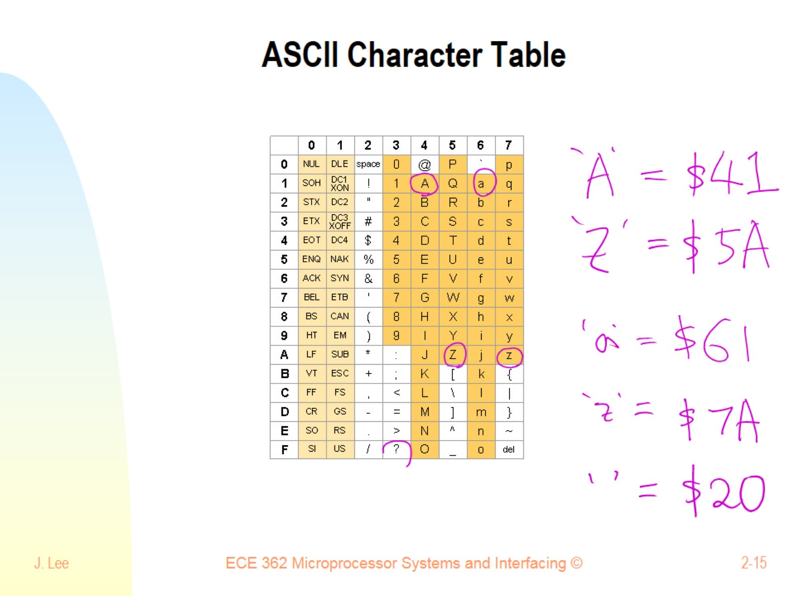
ASCII Character Table

Slide 16
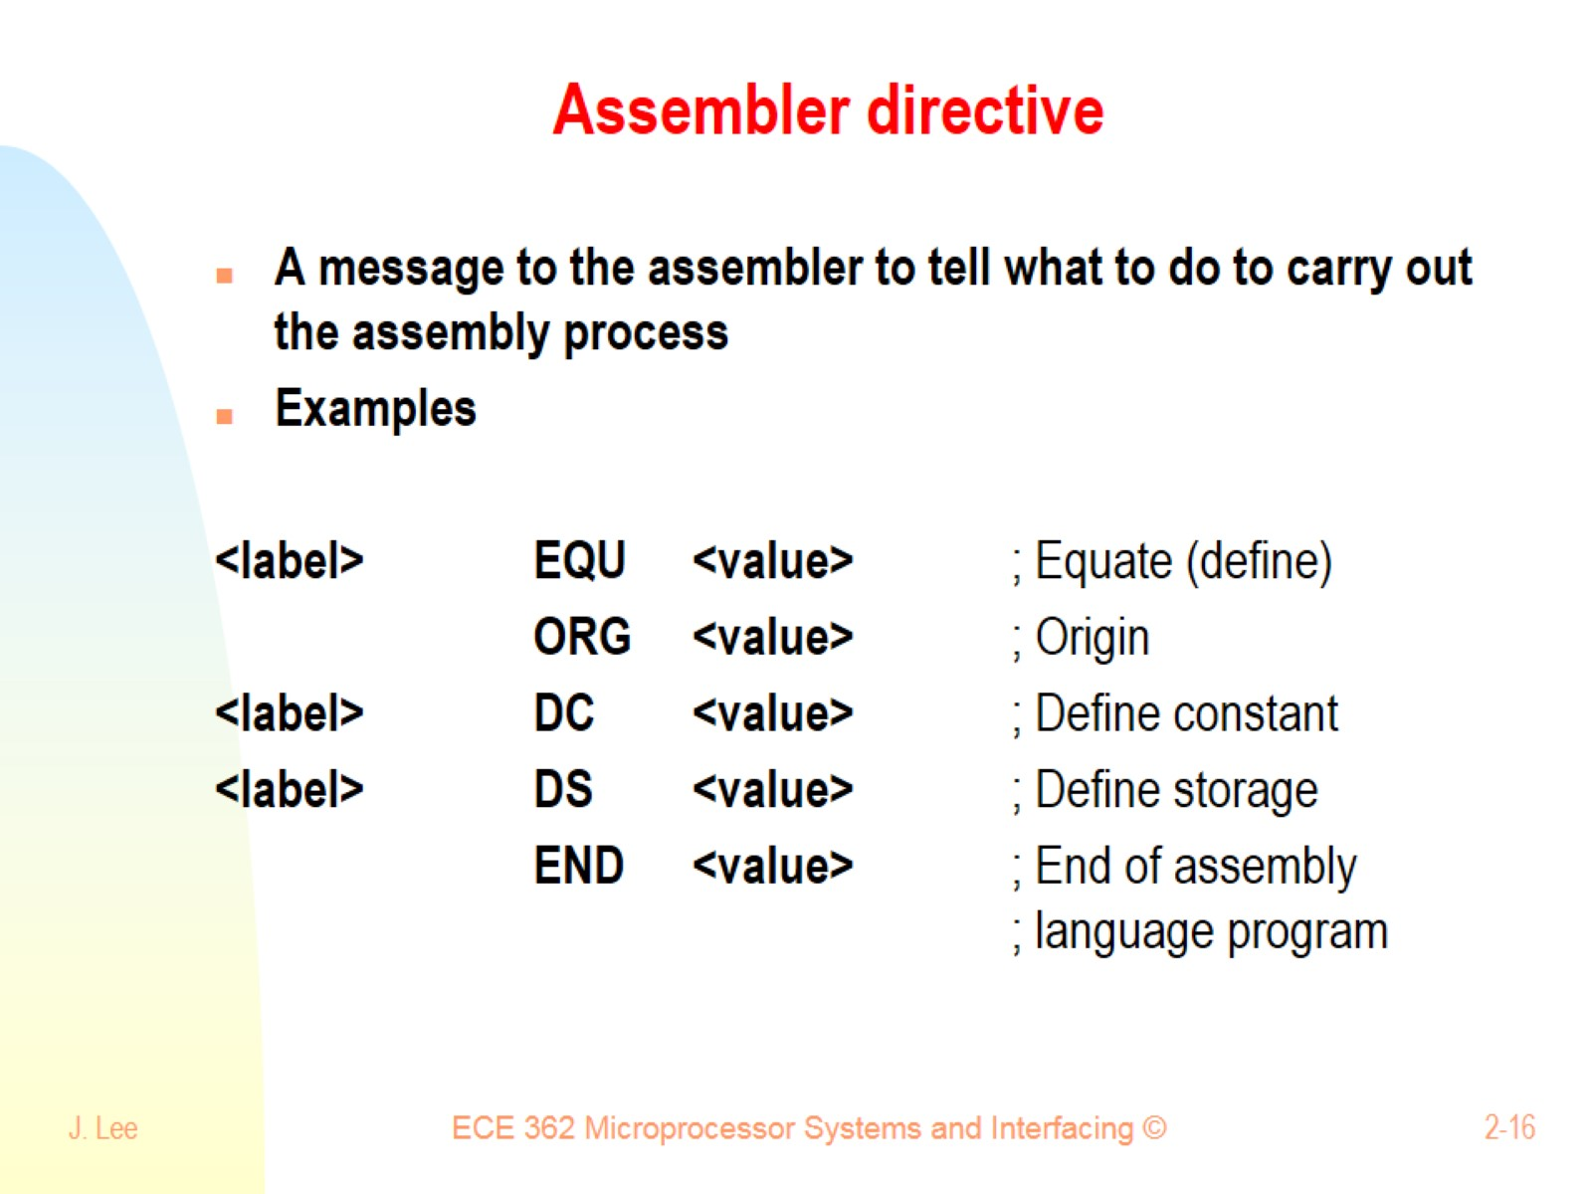
Assembler directive

Slide 17
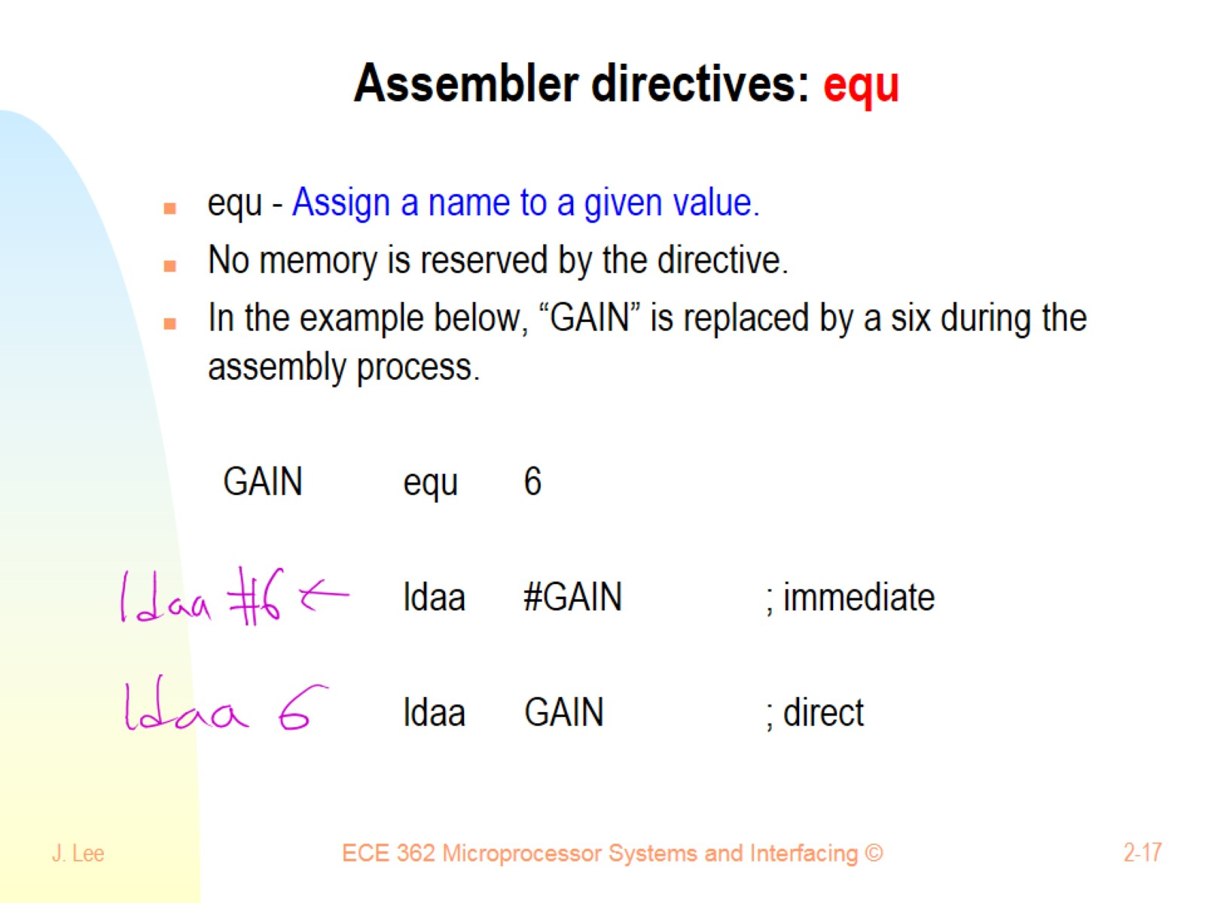
Assembler directives: equ

Slide 18
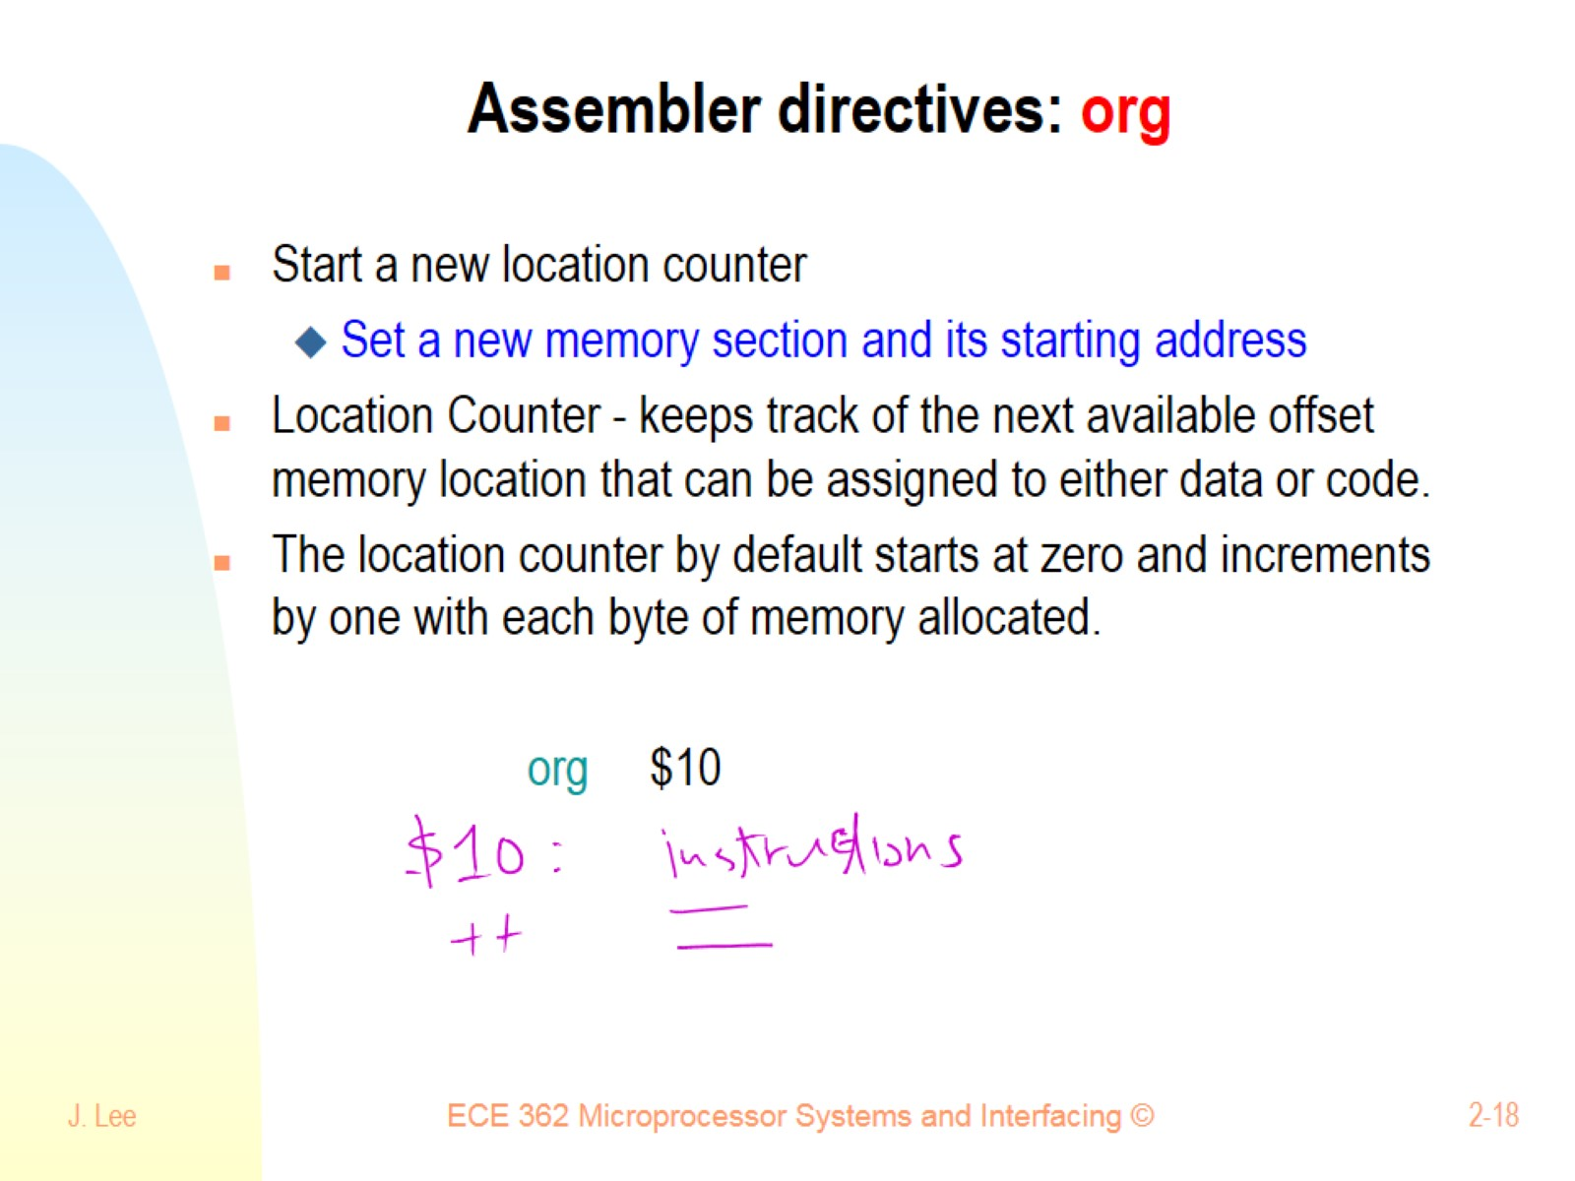
Assembler directives: org

Slide 19
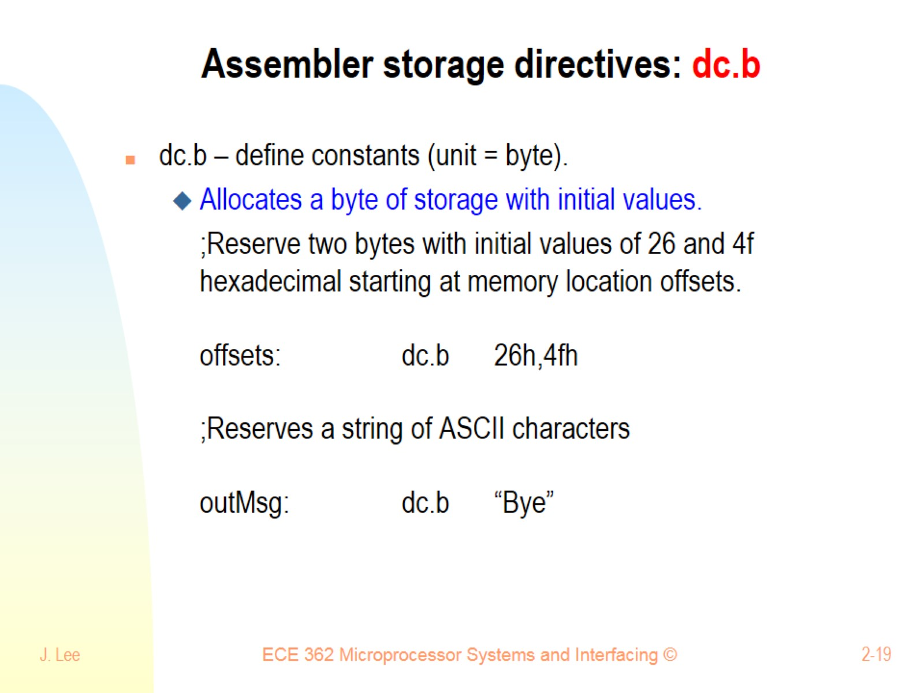
Assembler storage directives: dc.b

Slide 20
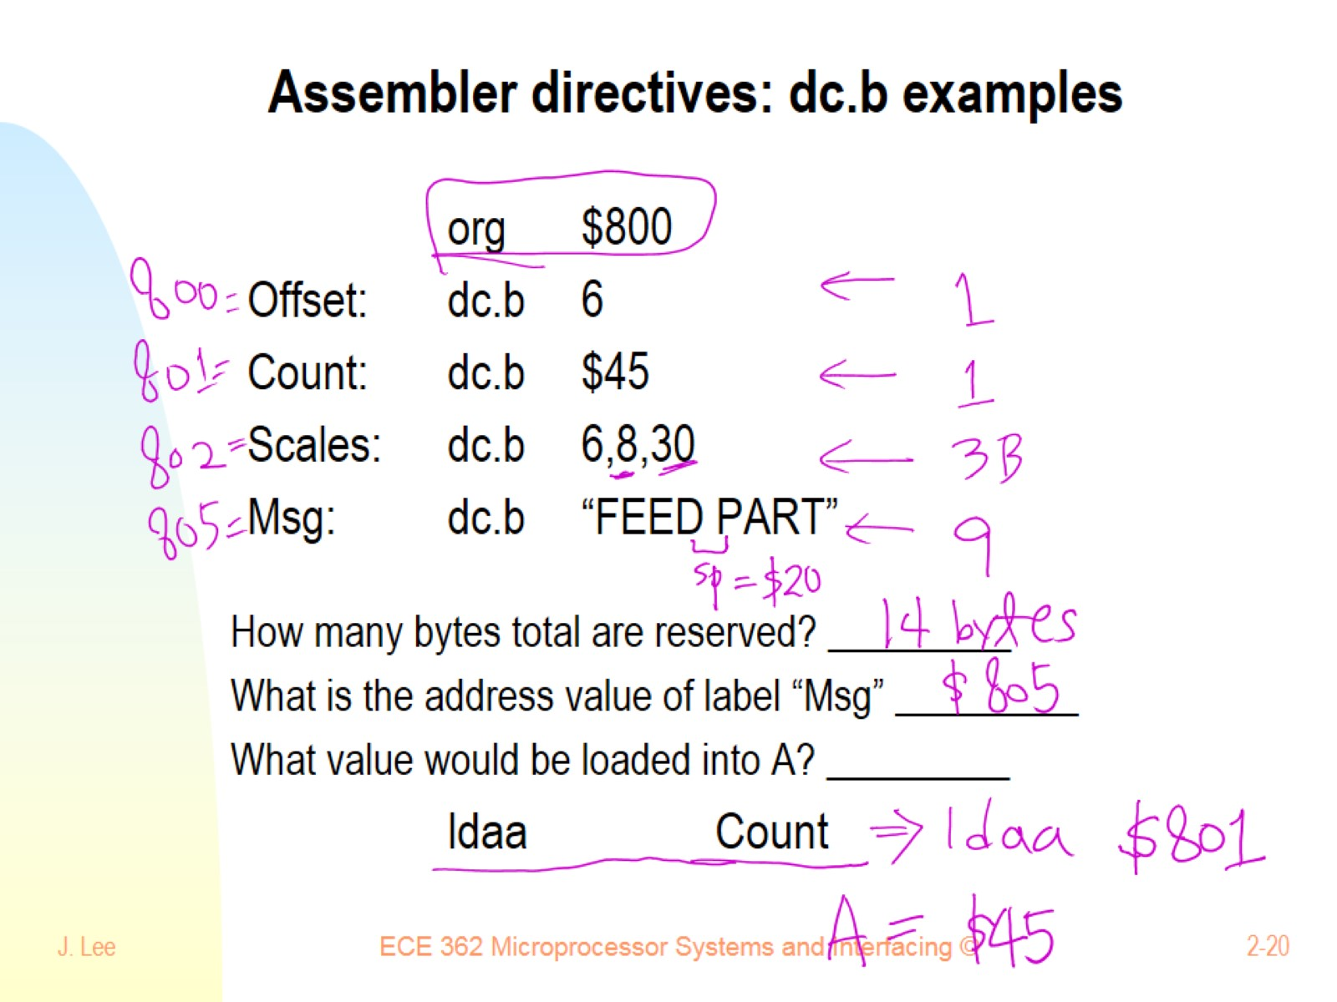
Assembler directives: dc.b examples

Slide 21
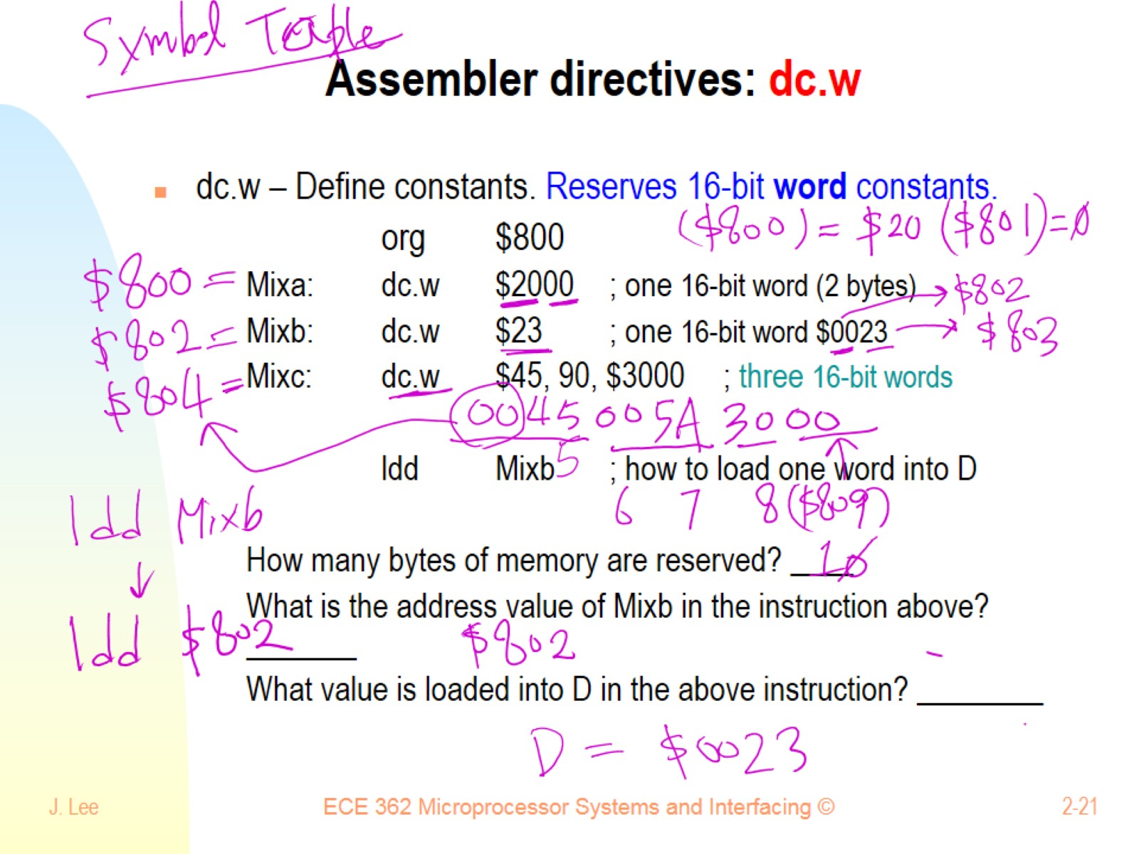
Assembler directives: dc.w

Slide 22
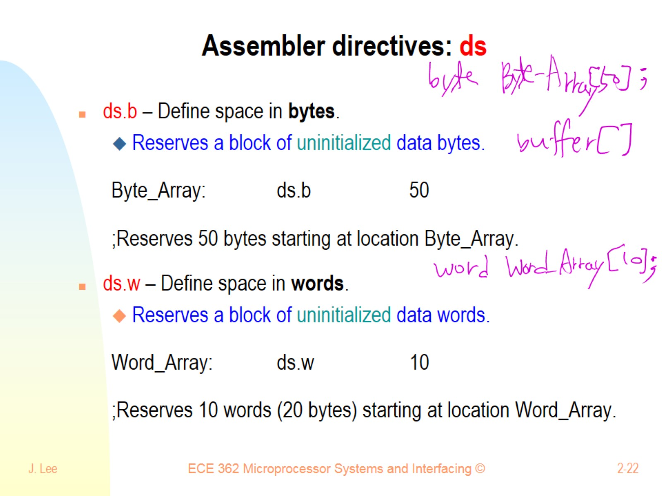
Assembler directives: ds

Slide 23
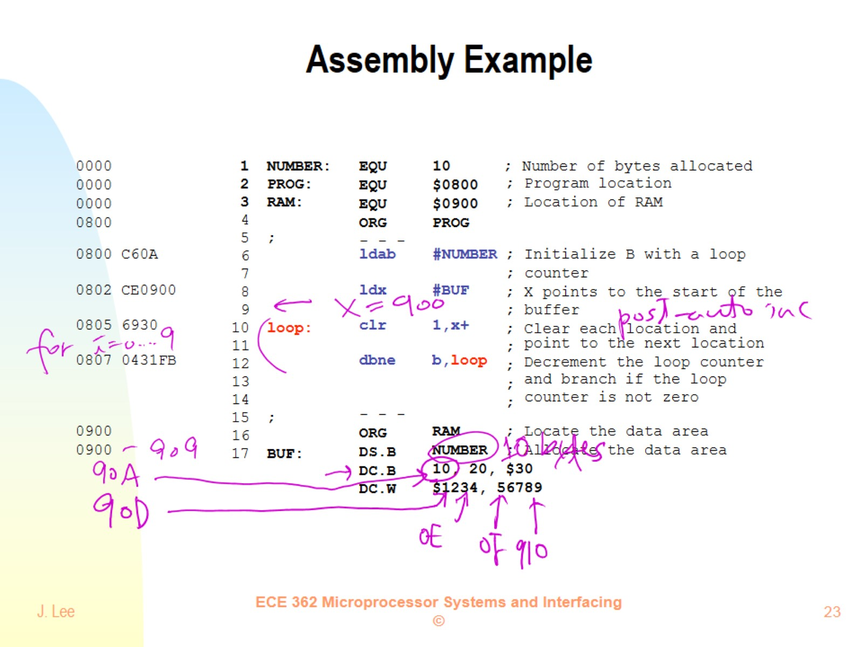
Assembly Example

Slide 24
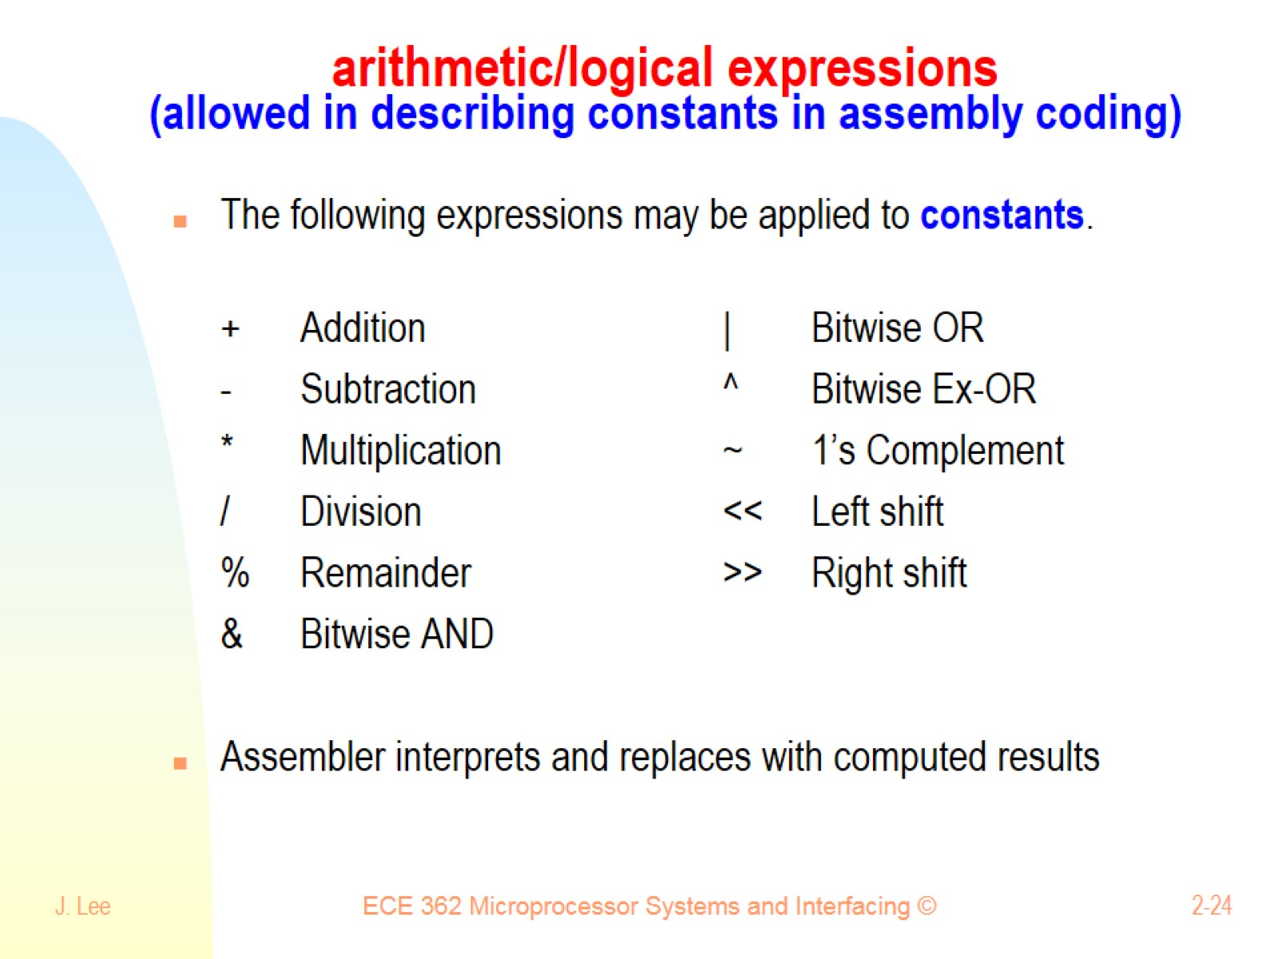
arithmetic/logical expressions (allowed in describing constants in assembly coding)

Slide 25
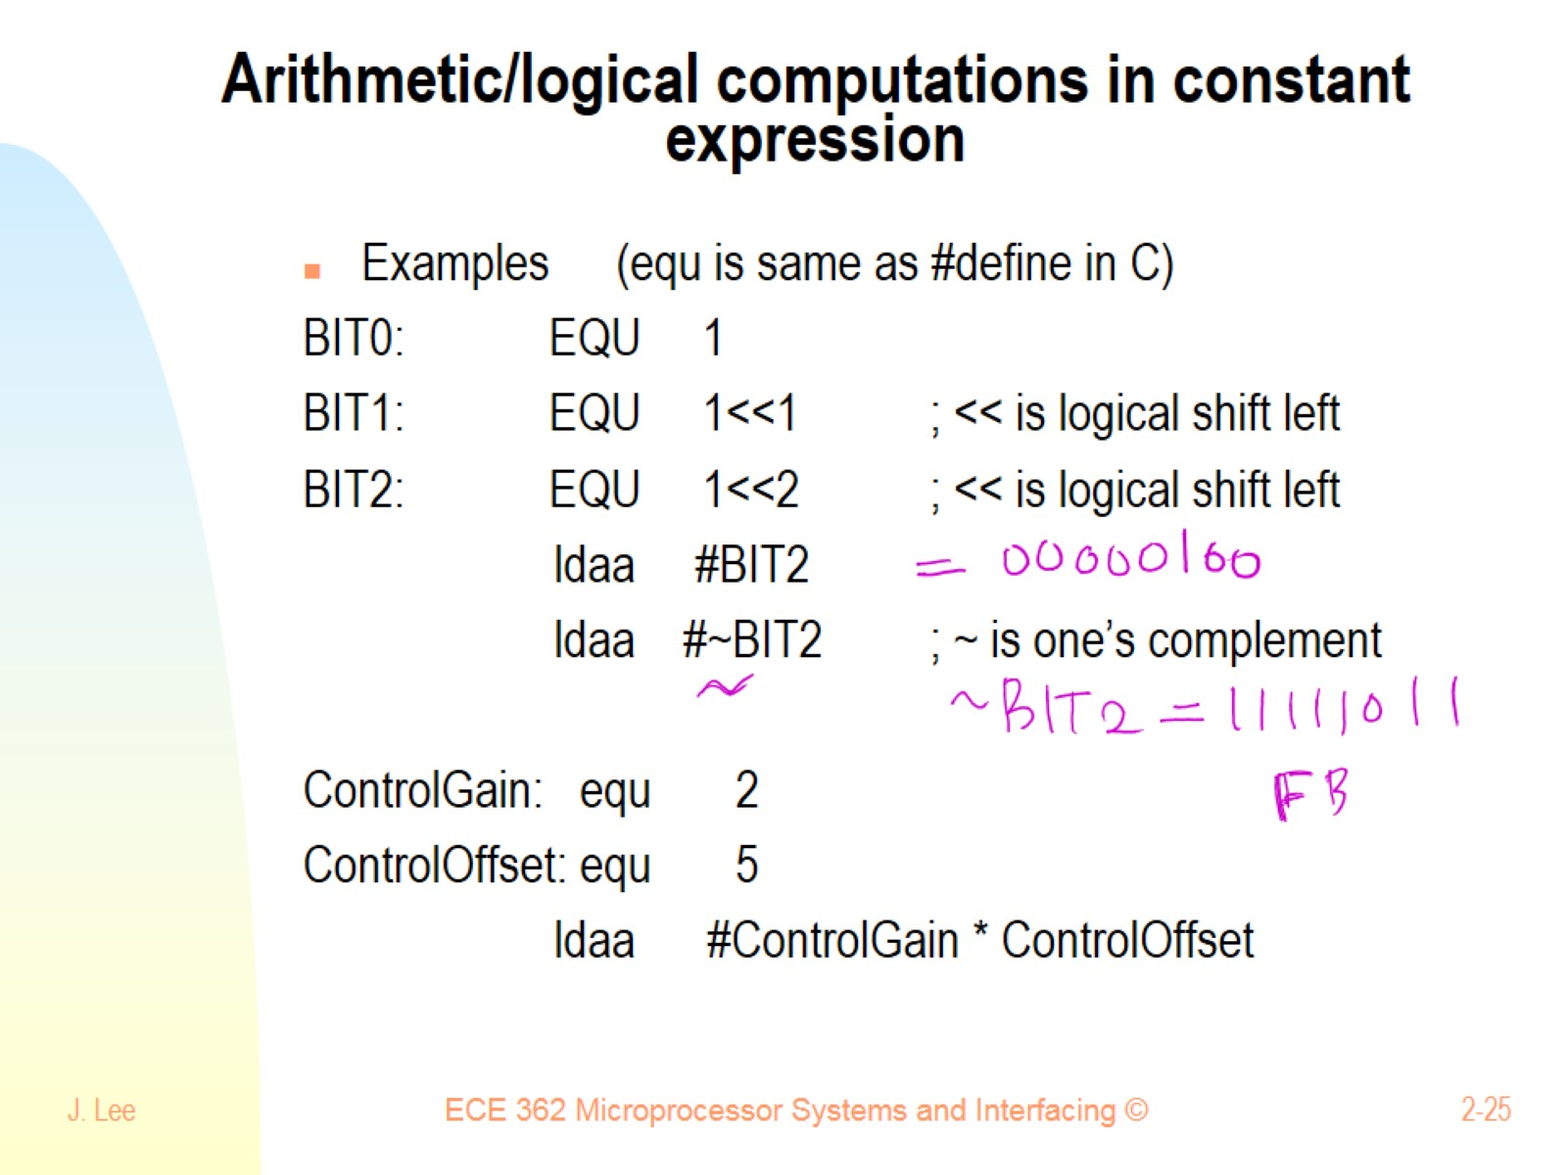
Arithmetic/logical computations in constant expression

Slide 26
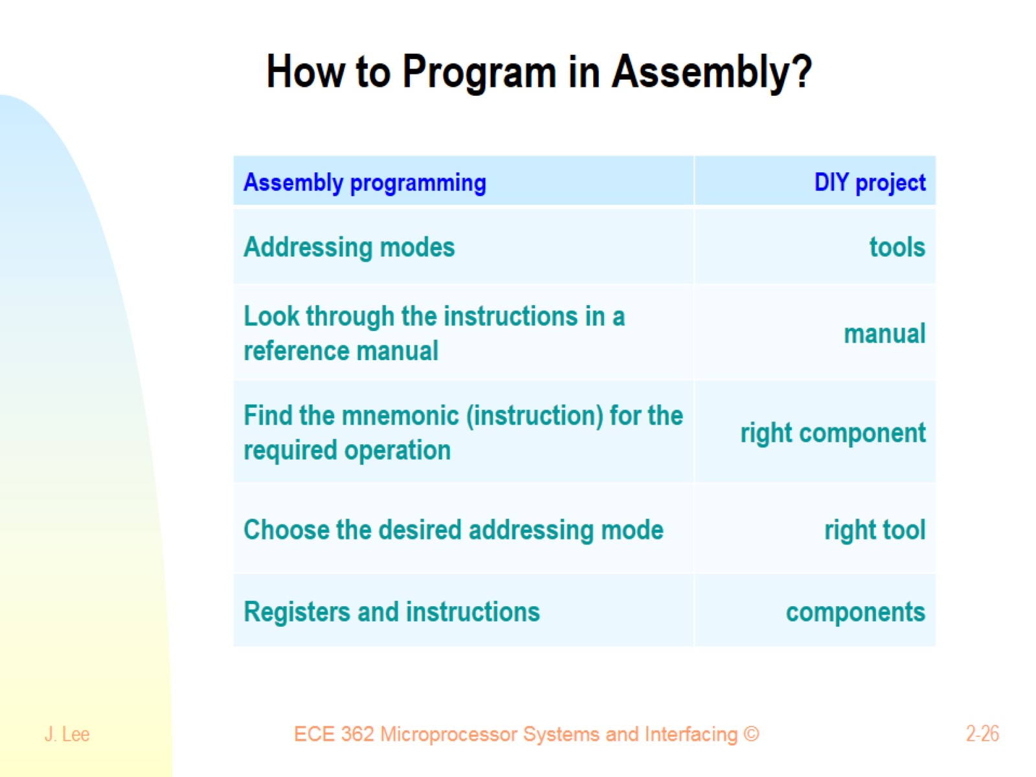
How to Program in Assembly?

Slide 27
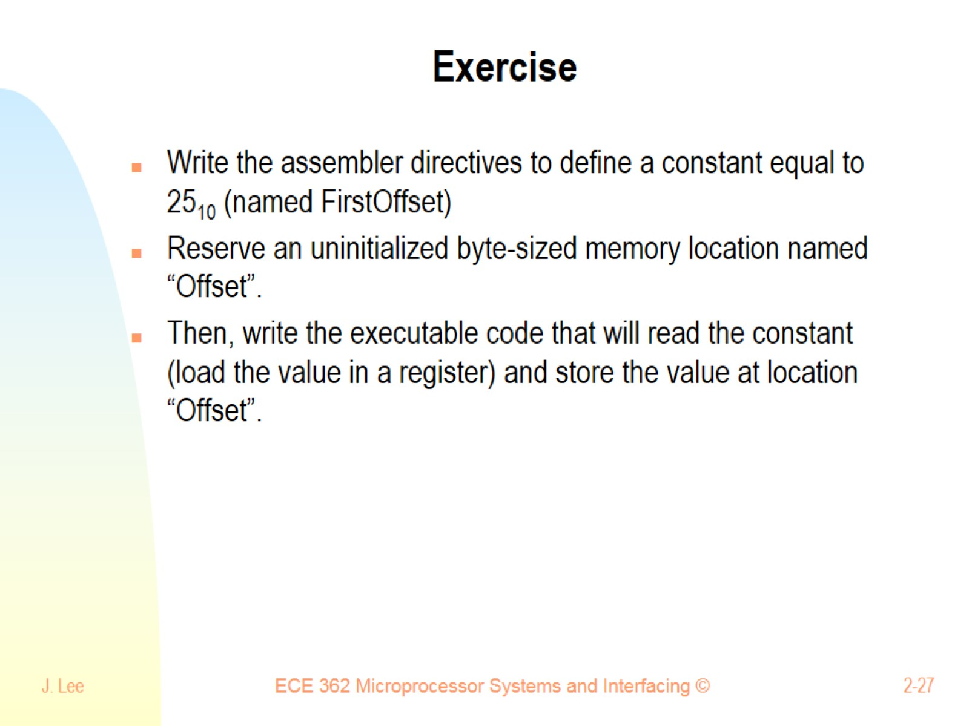
Exercise

Slide 28
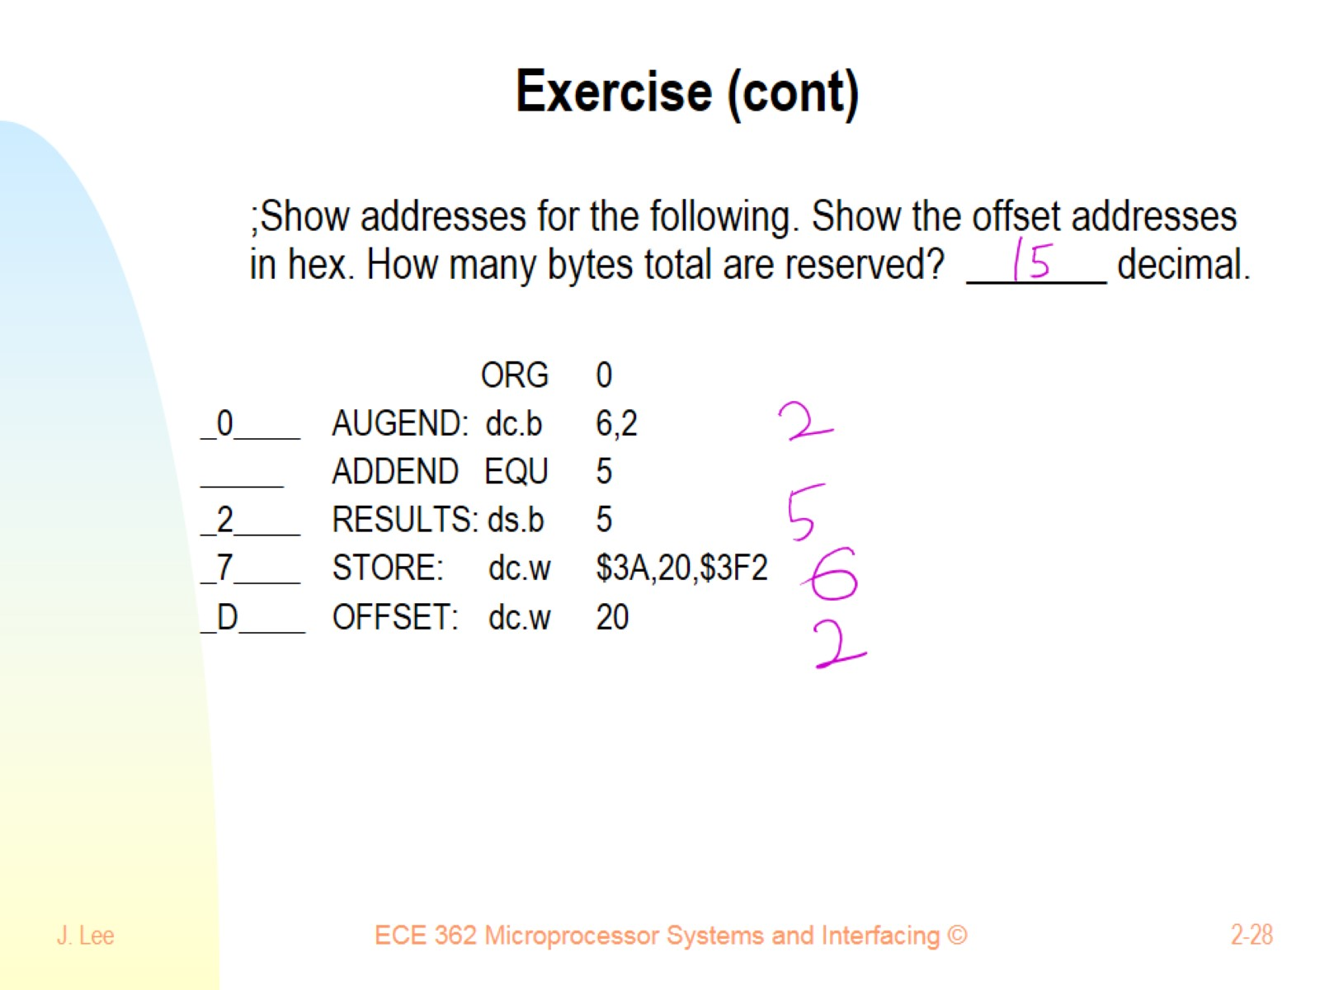
Exercise (cont)

Slide 29
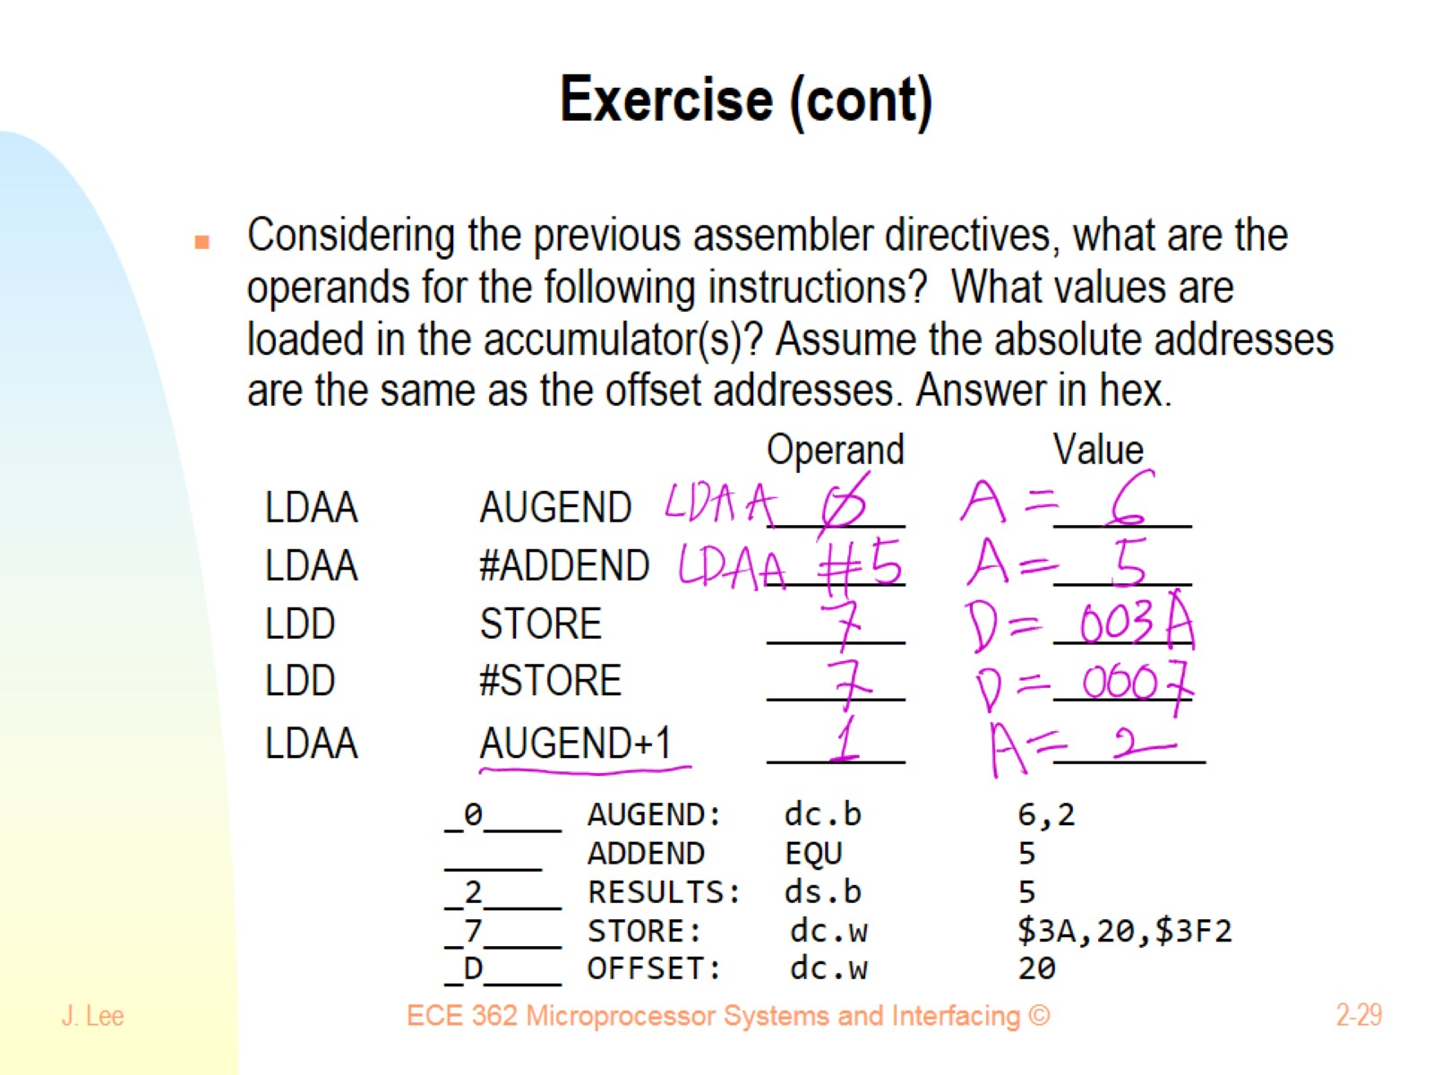
Exercise (cont)

Slide 30
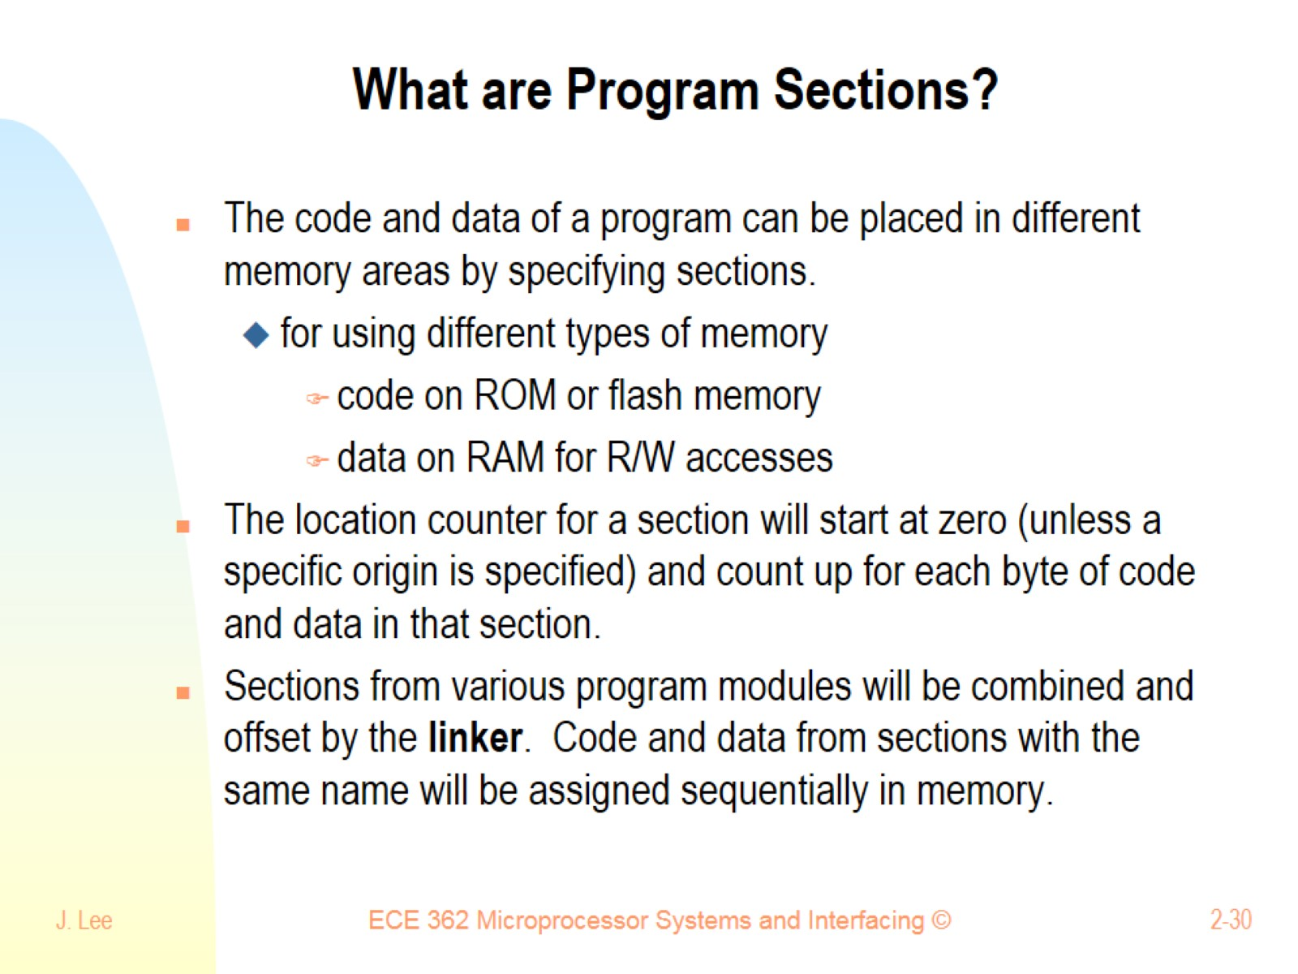
What are Program Sections?

Slide 31
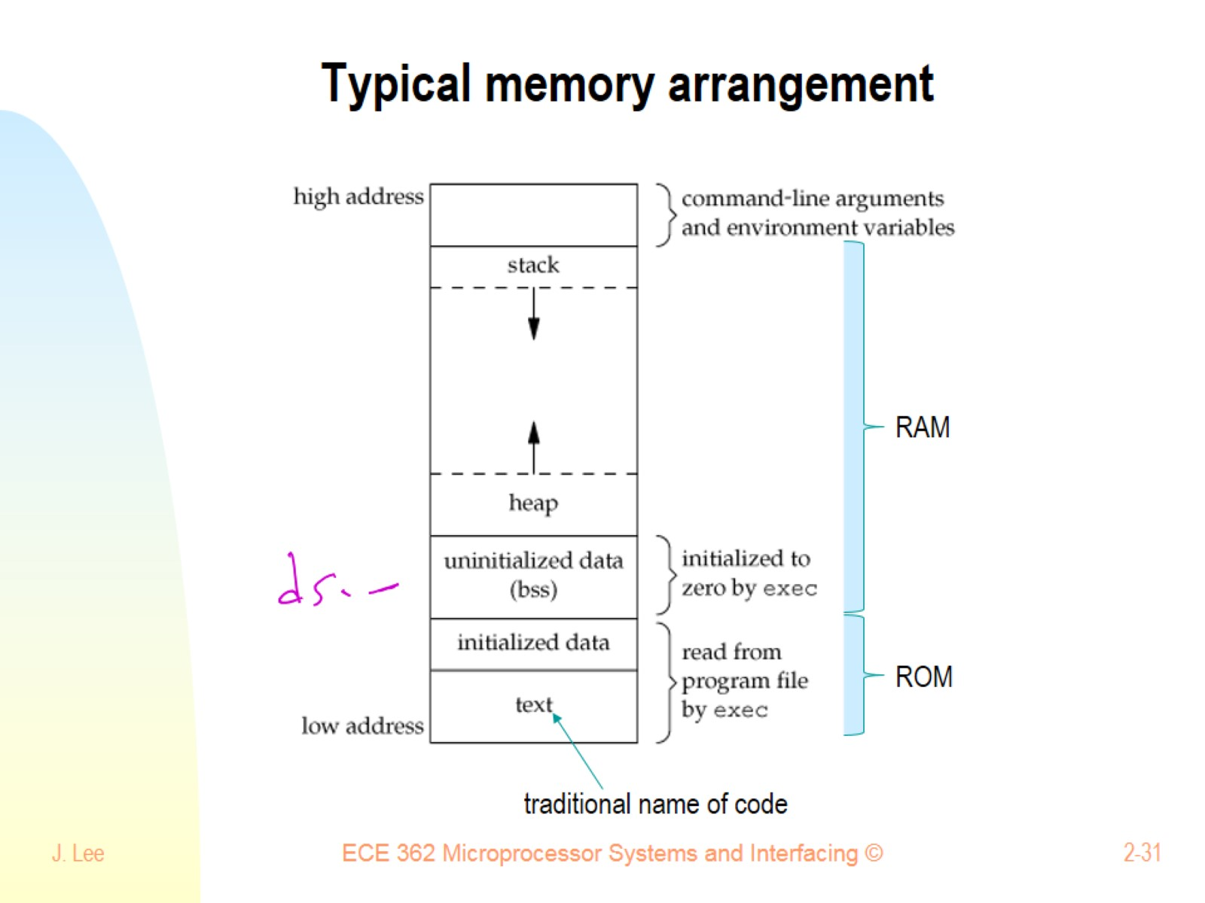
Typical memory arrangement

Slide 32
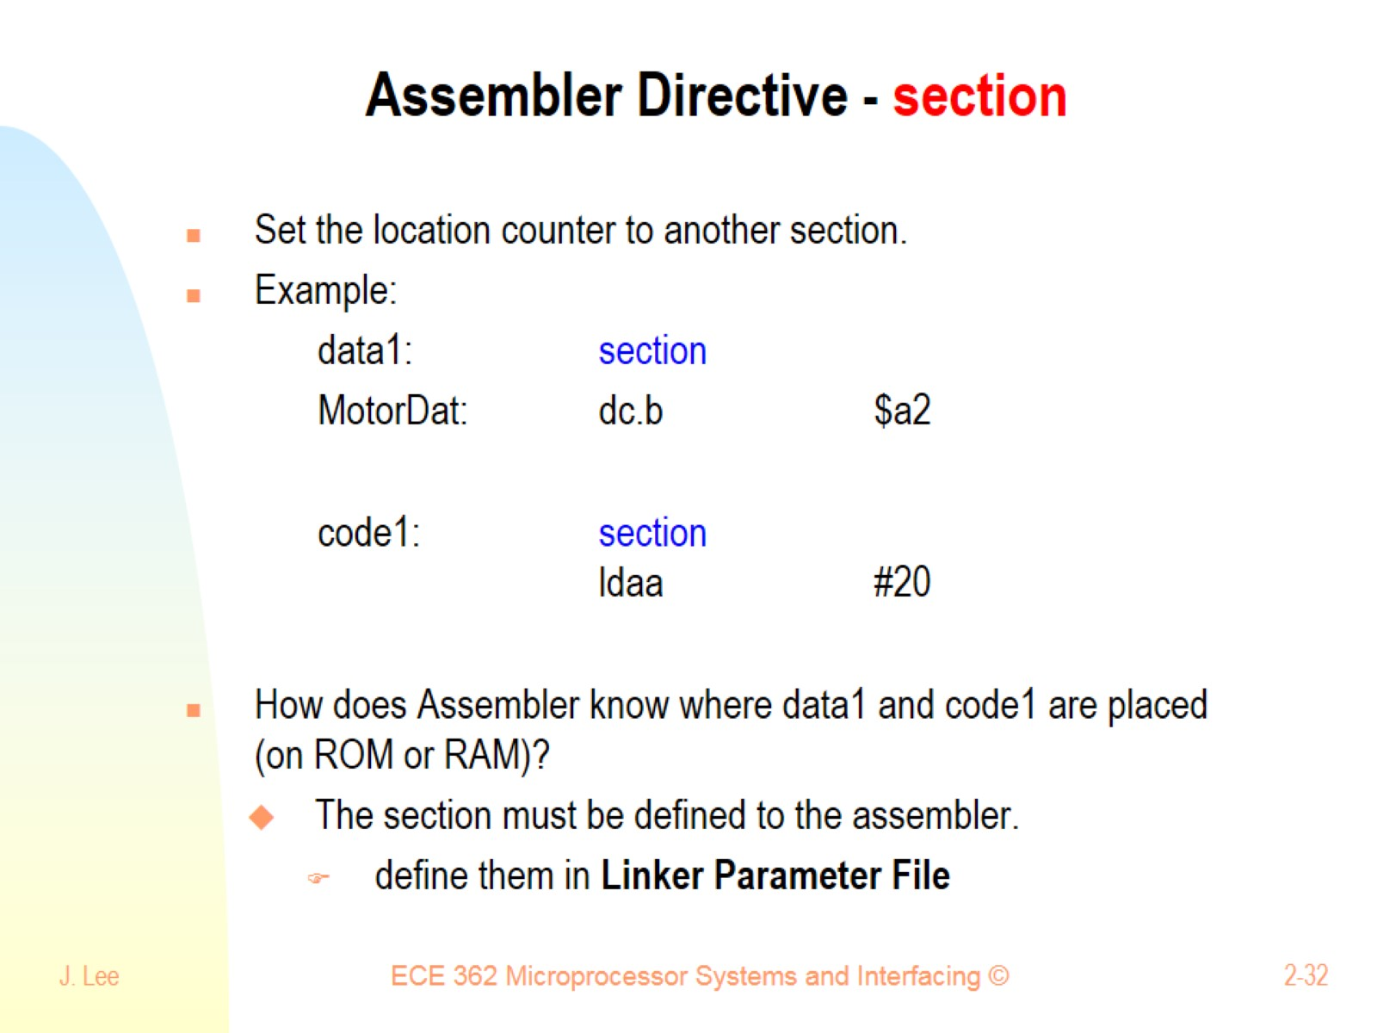
Assembler Directive - section

Slide 33
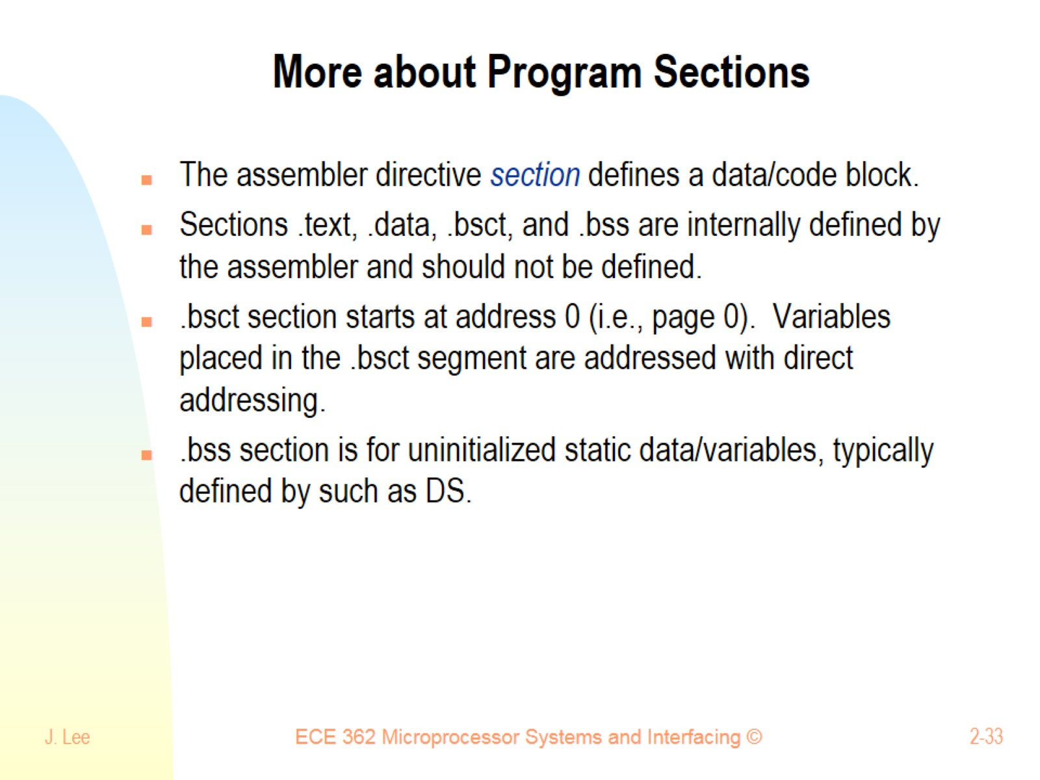
More about Program Sections

Slide 34
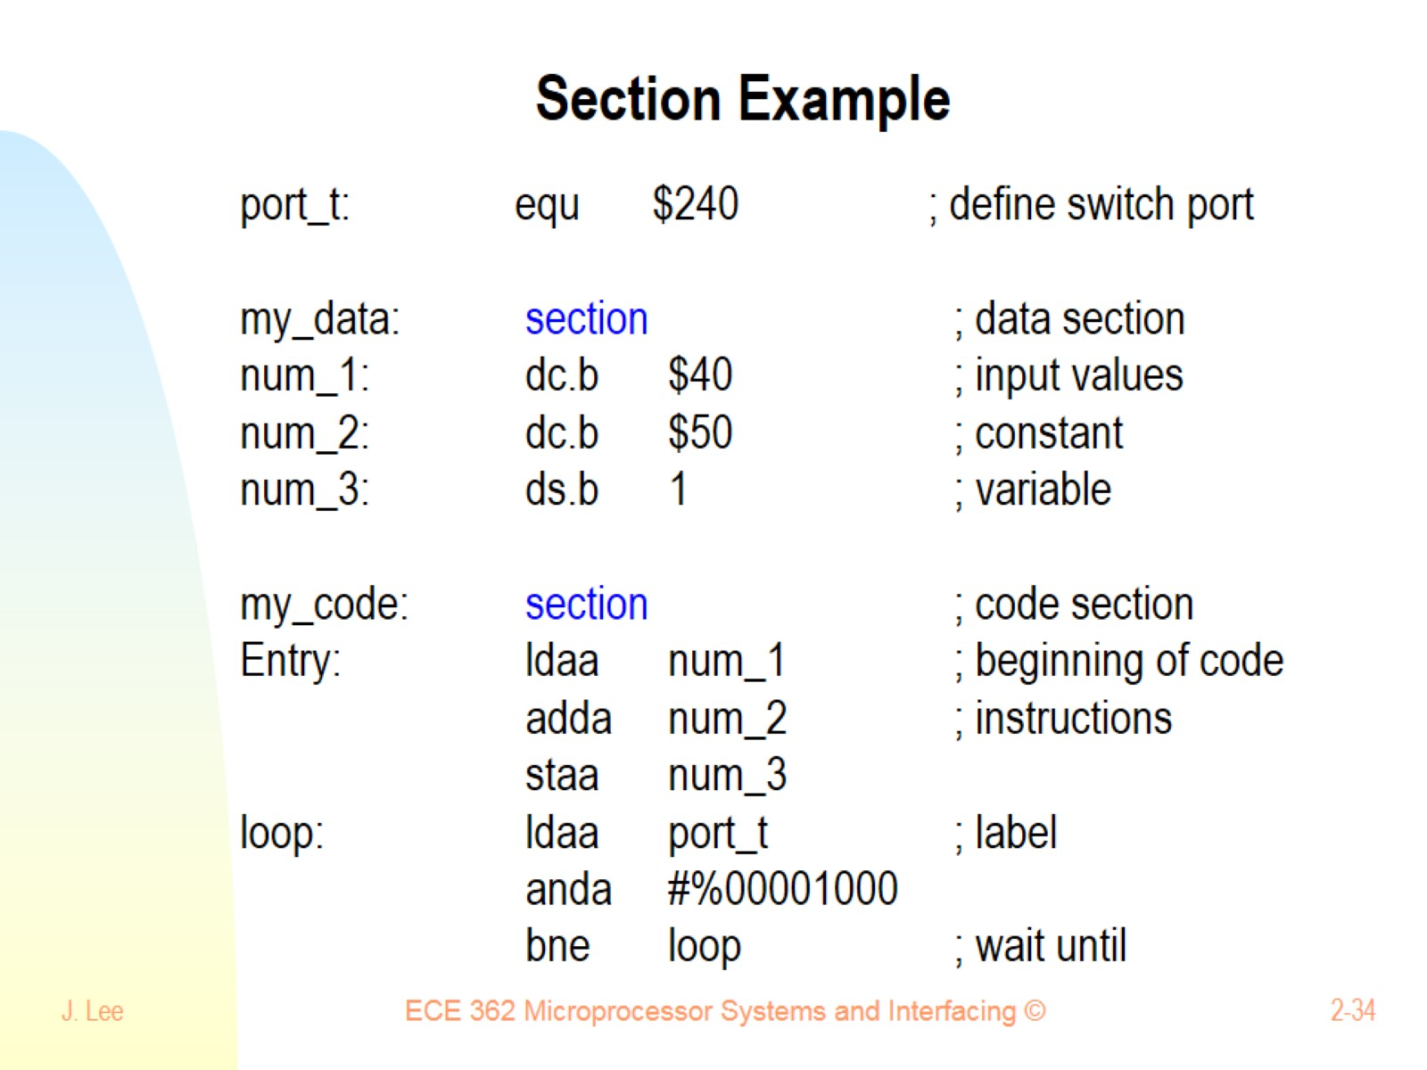
Section Example

Slide 35
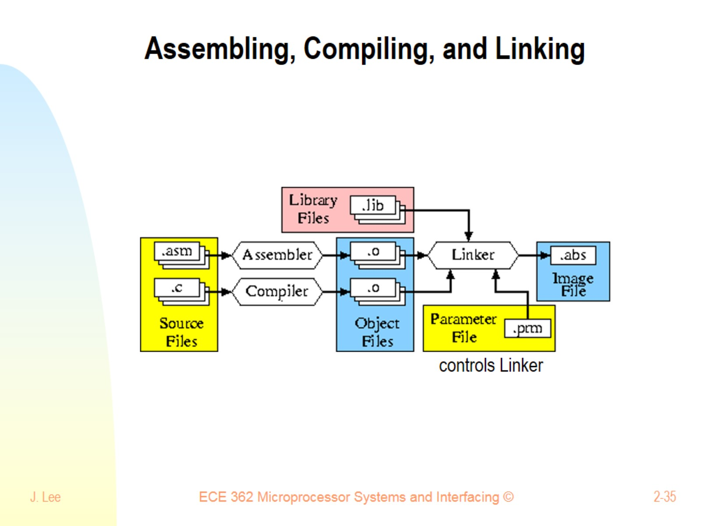
Assembling, Compiling, and Linking

Slide 36
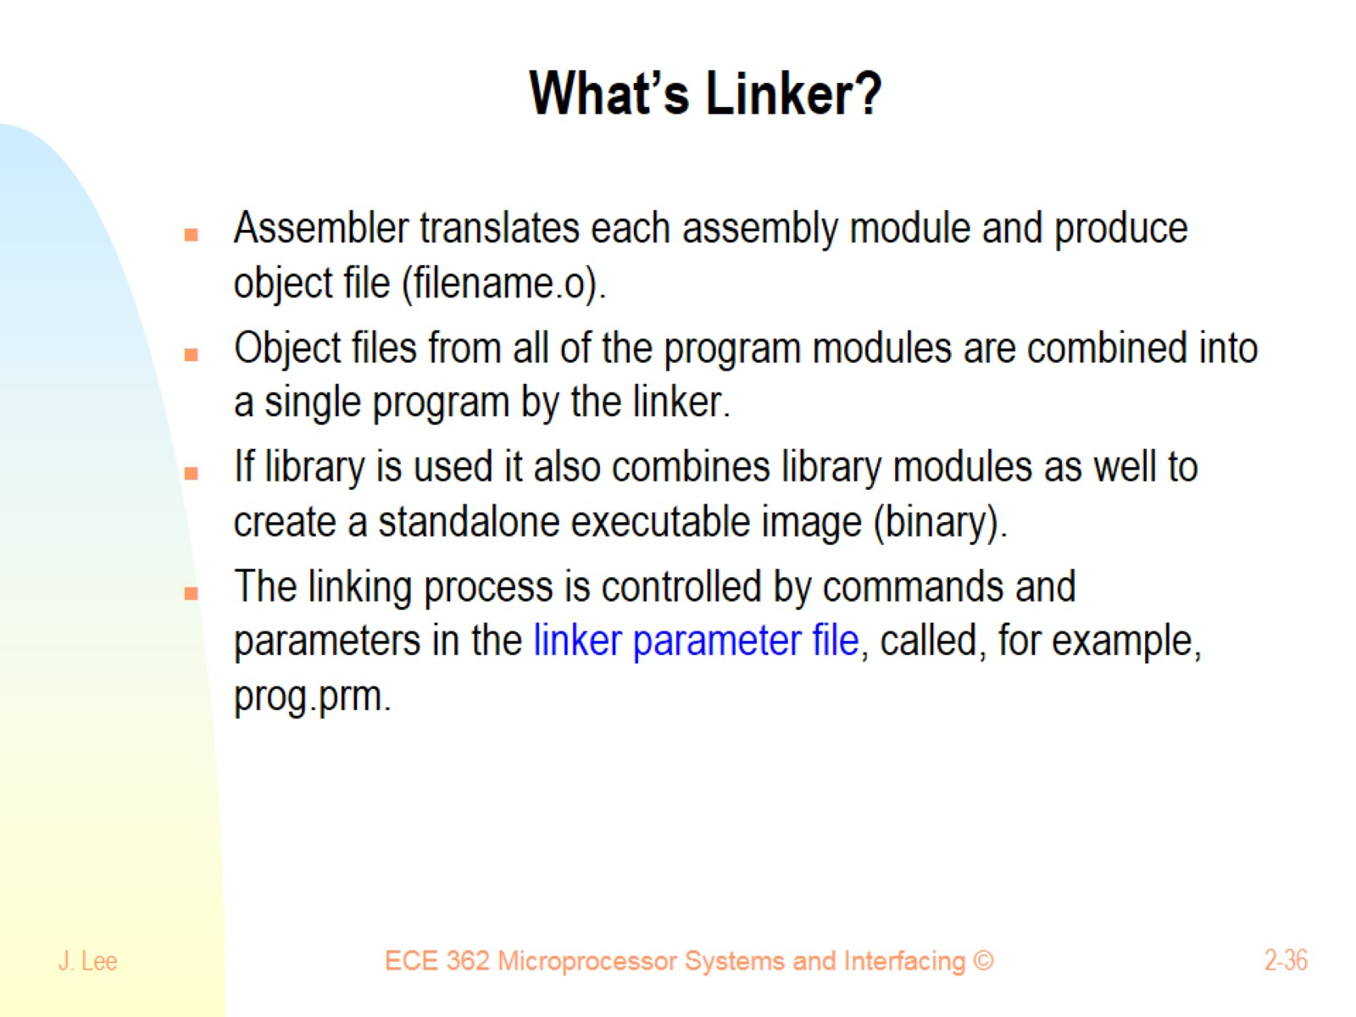
What’s Linker?

Slide 37
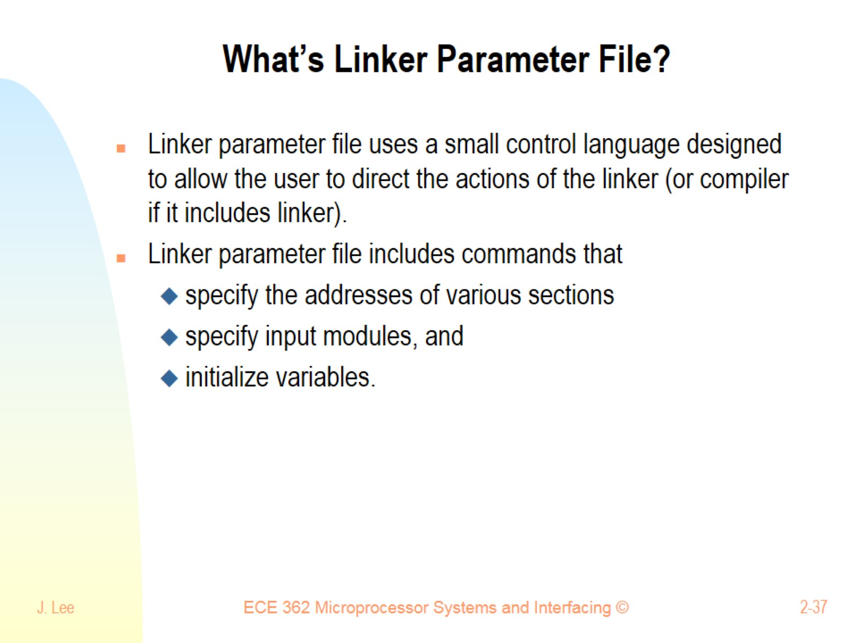
What’s Linker Parameter File?

Slide 38
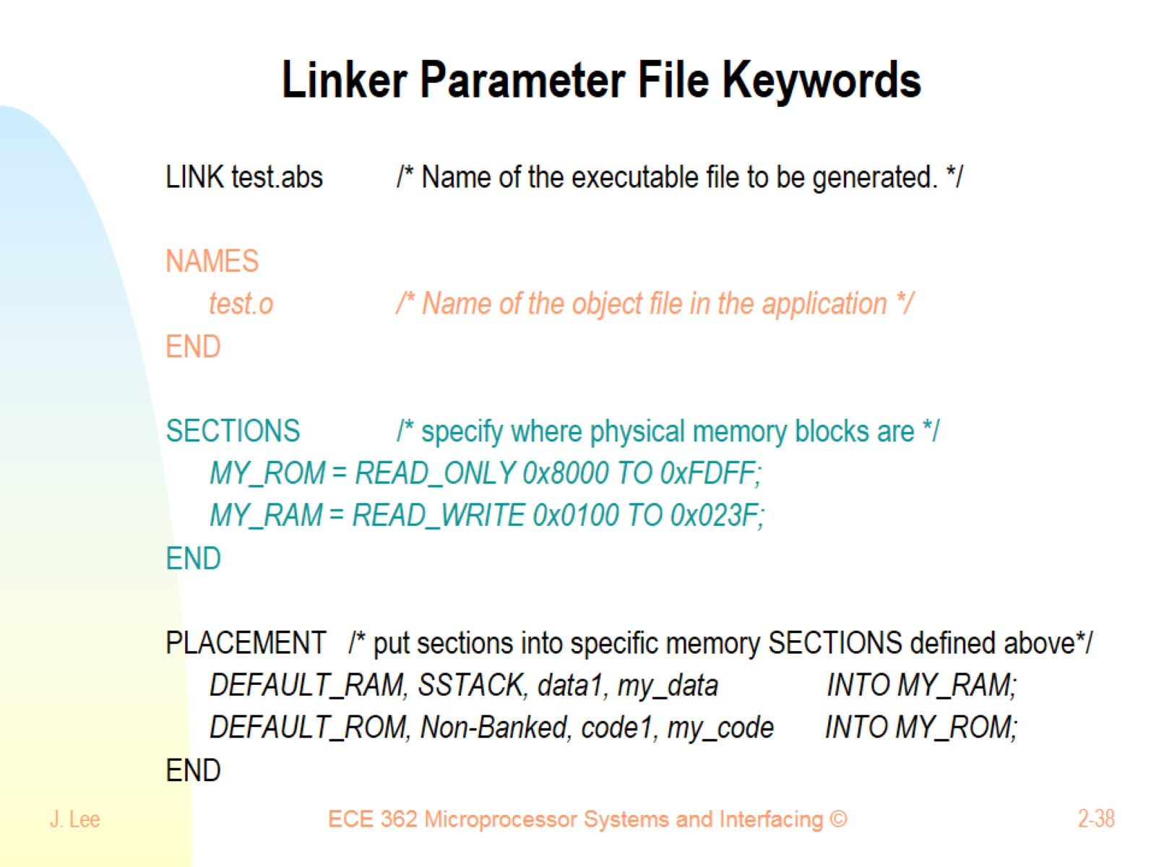
Linker Parameter File Keywords

Slide 39
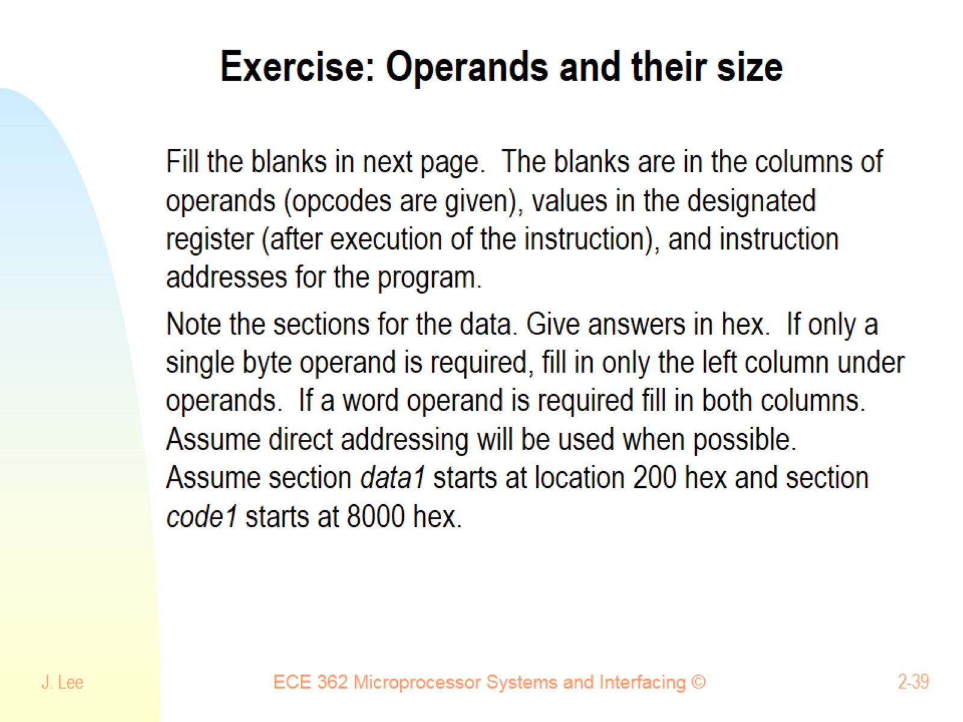
Exercise: Operands and their size

Slide 40
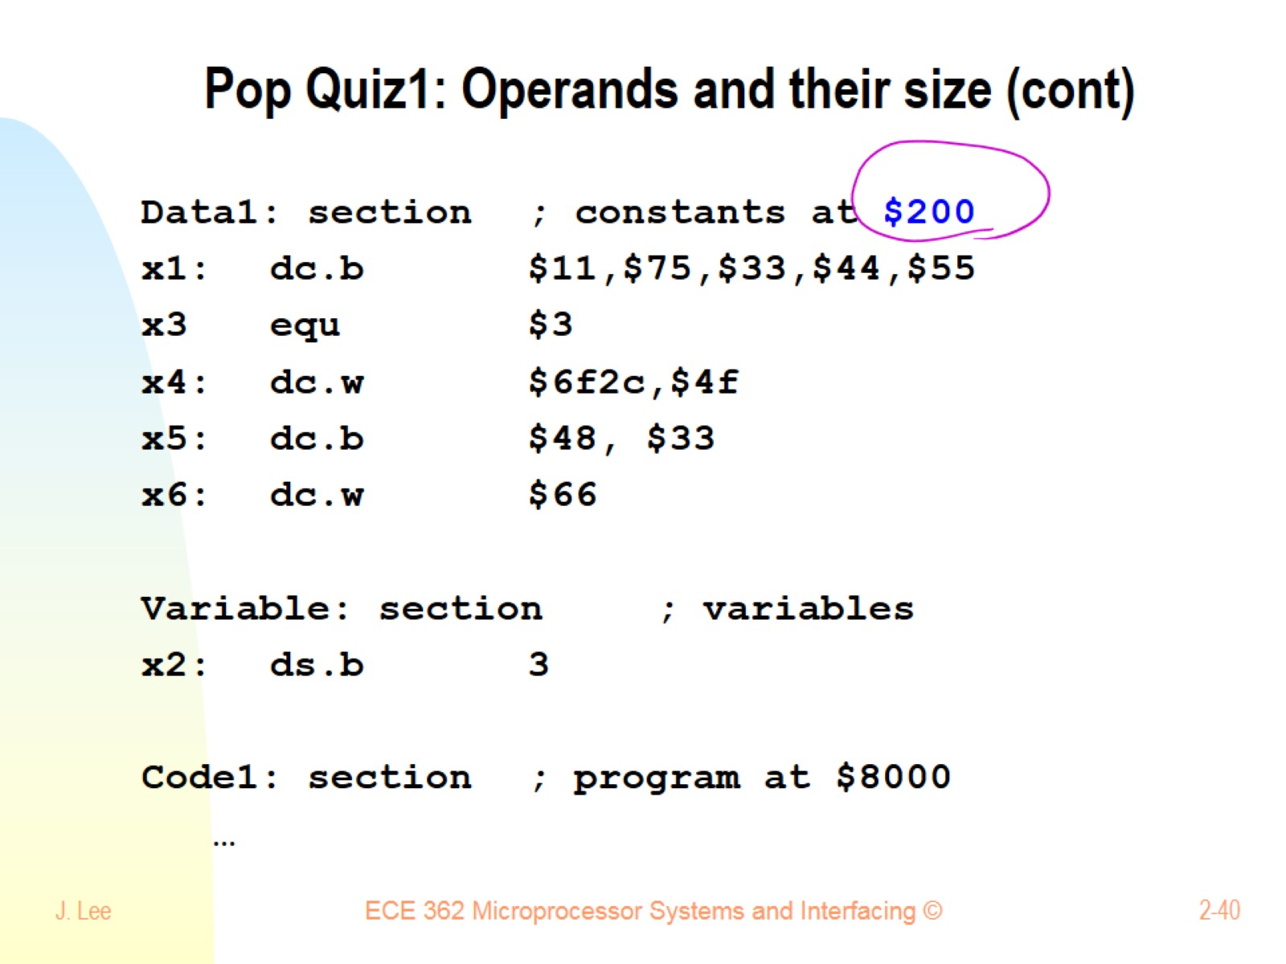
Pop Quiz1: Operands and their size (cont)

Slide 41
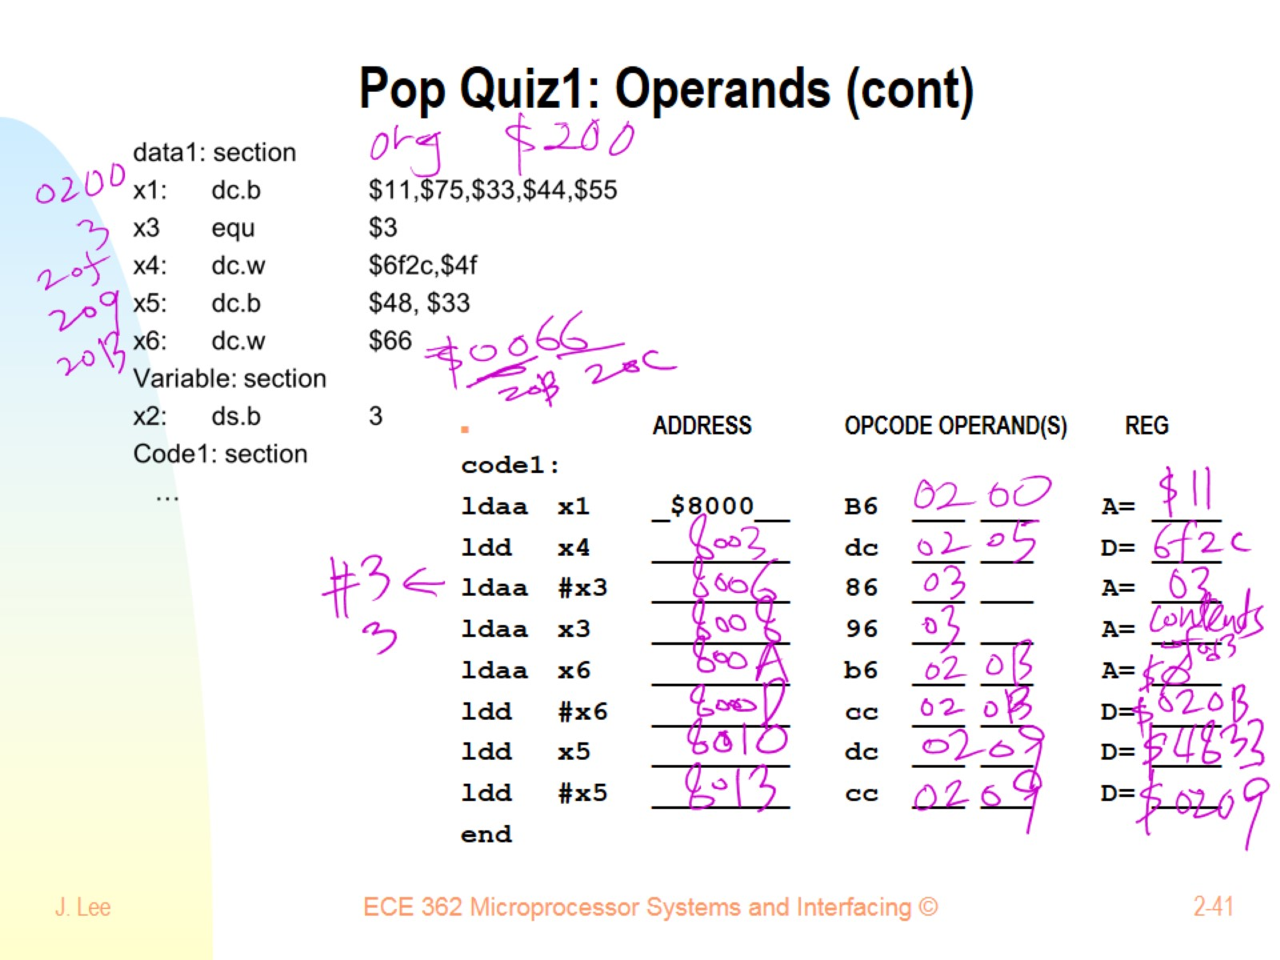
Pop Quiz1: Operands (cont)

Slide 42
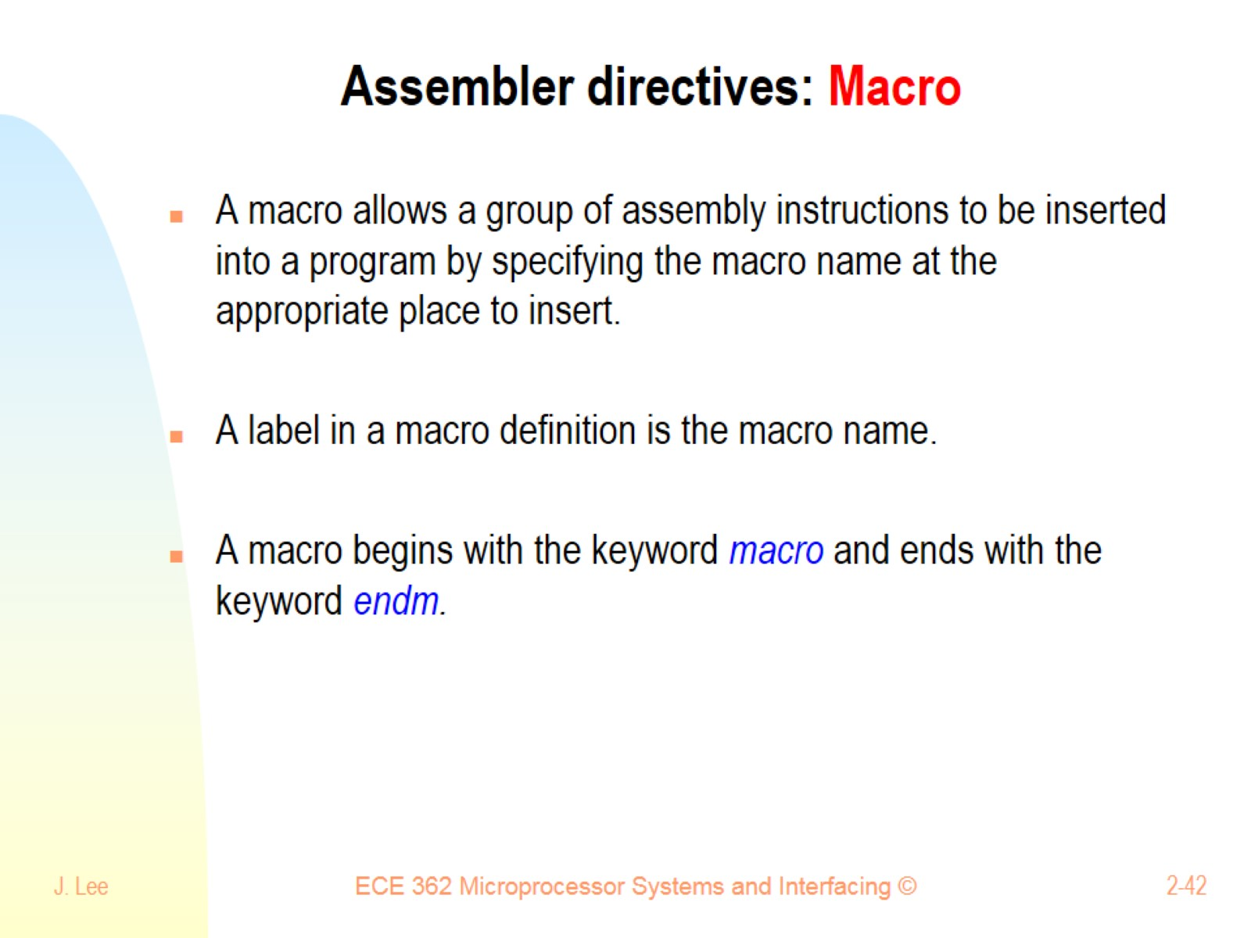
Assembler directives: Macro

Slide 43
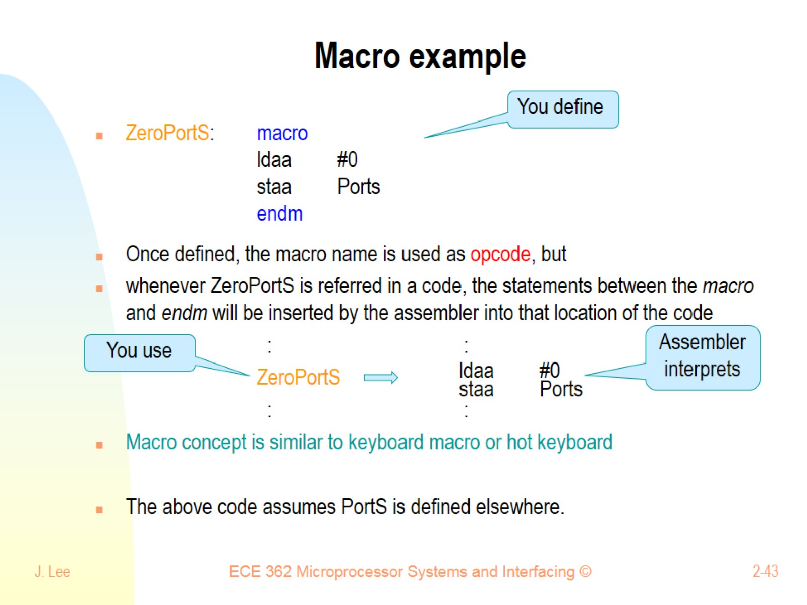
Macro example

Slide 44
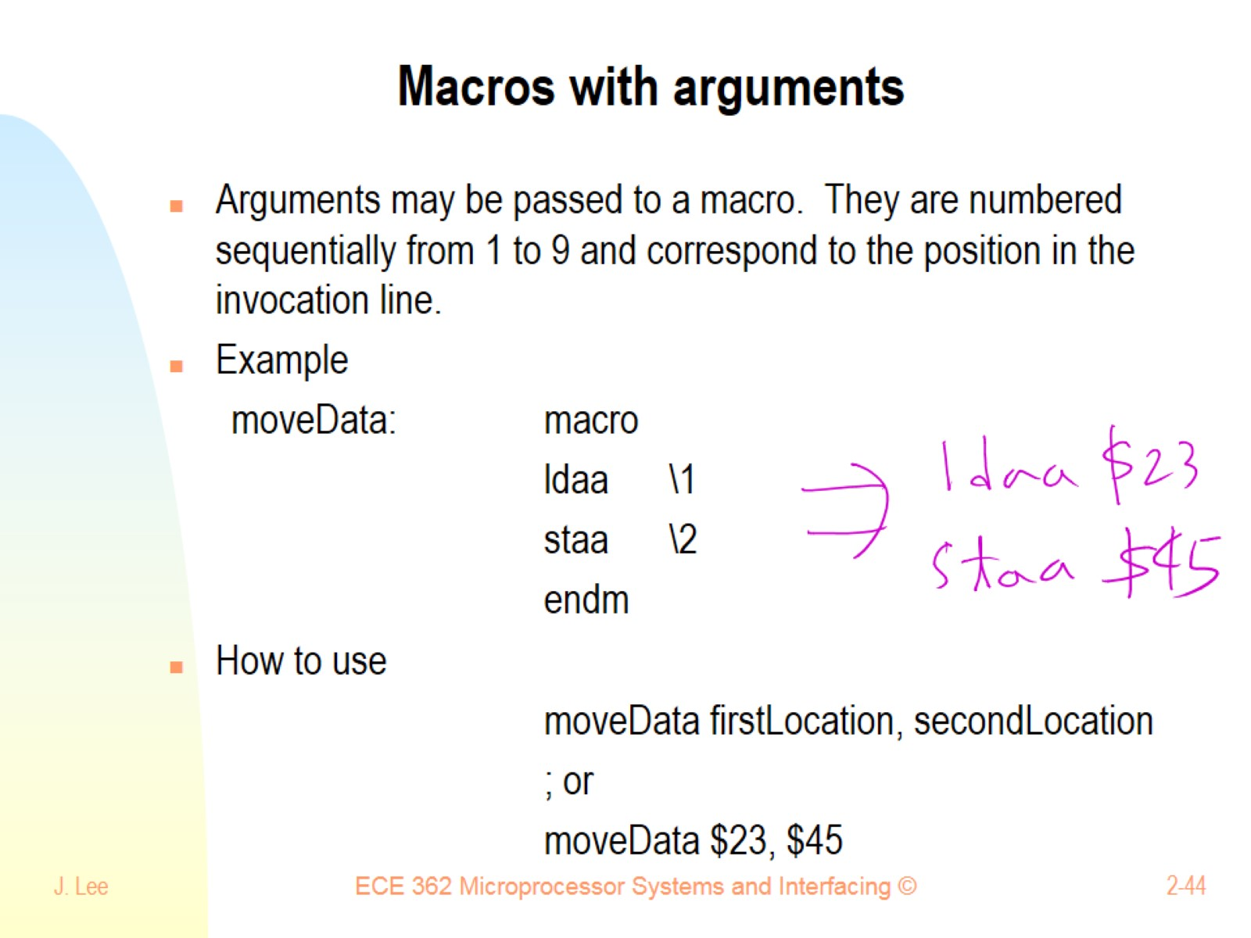
Macros with arguments

Slide 45
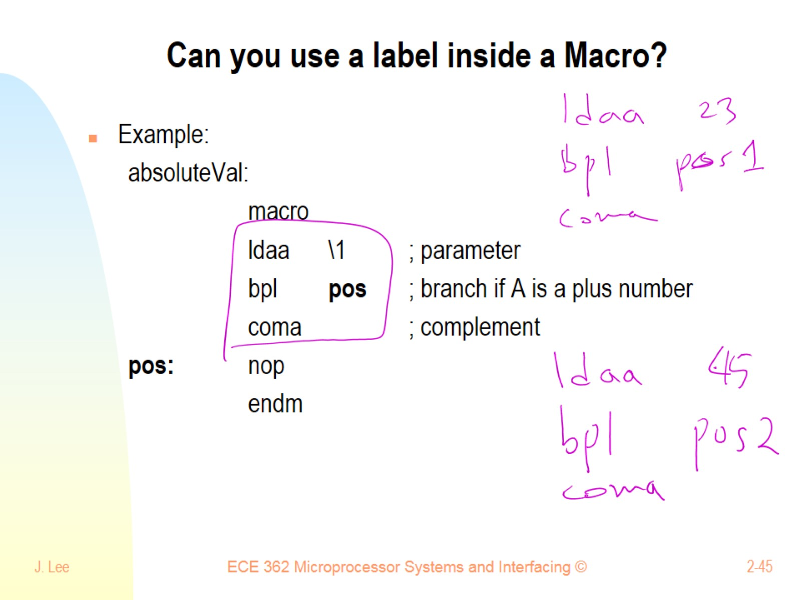
Can you use a label inside a Macro?

Slide 46
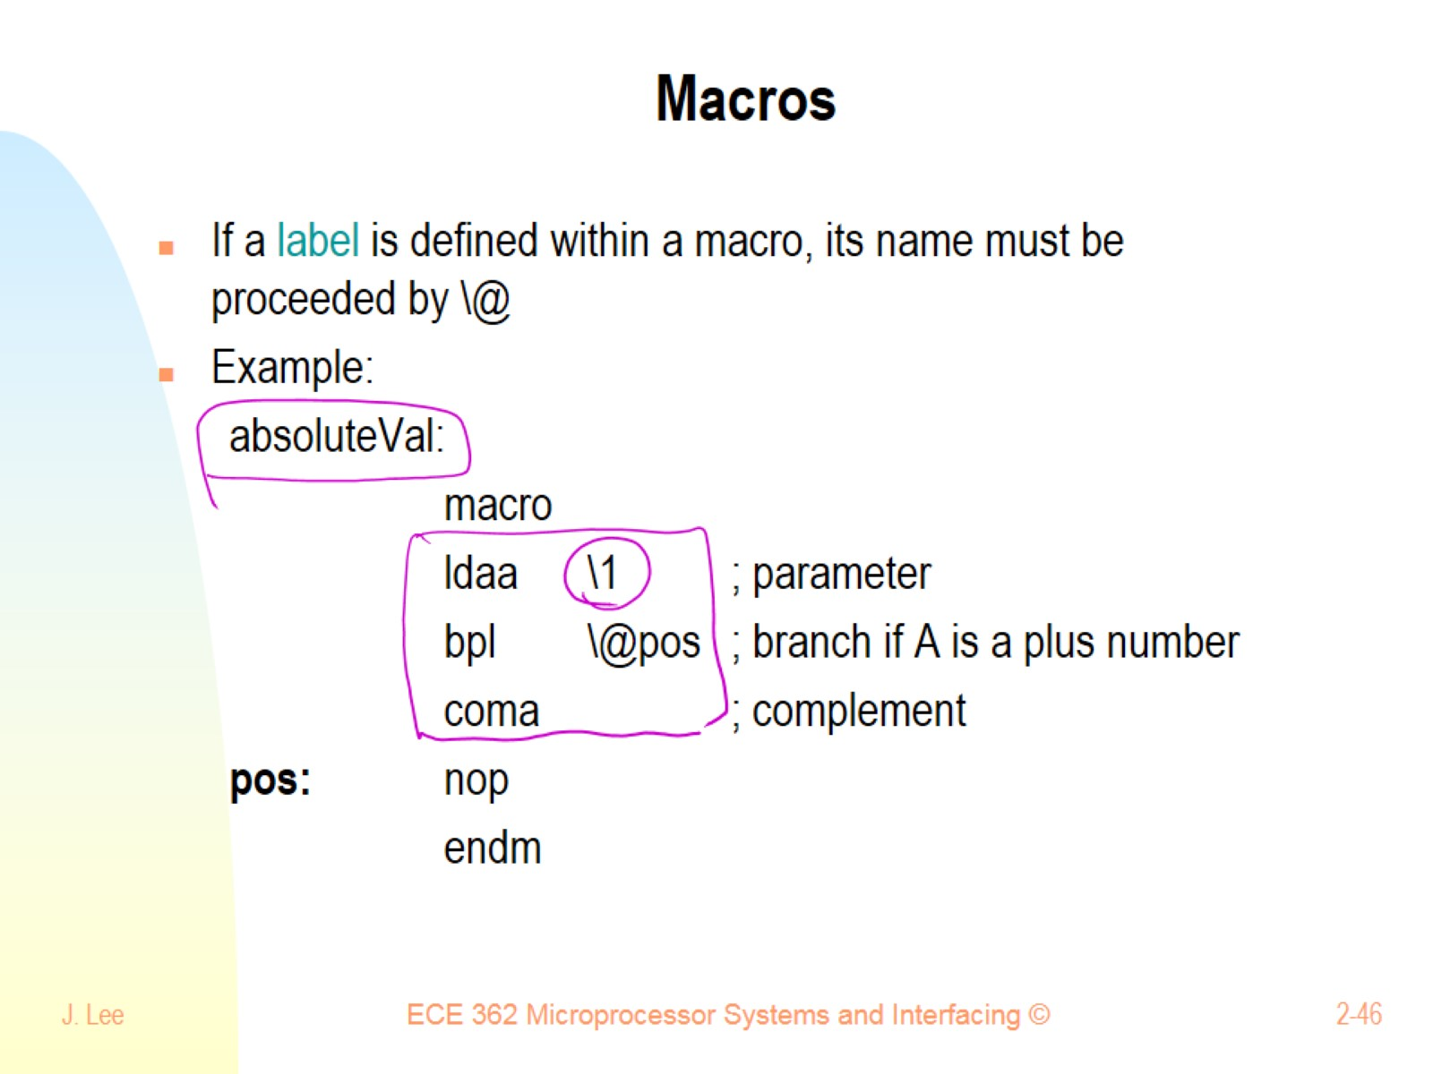
Macros

Slide 47
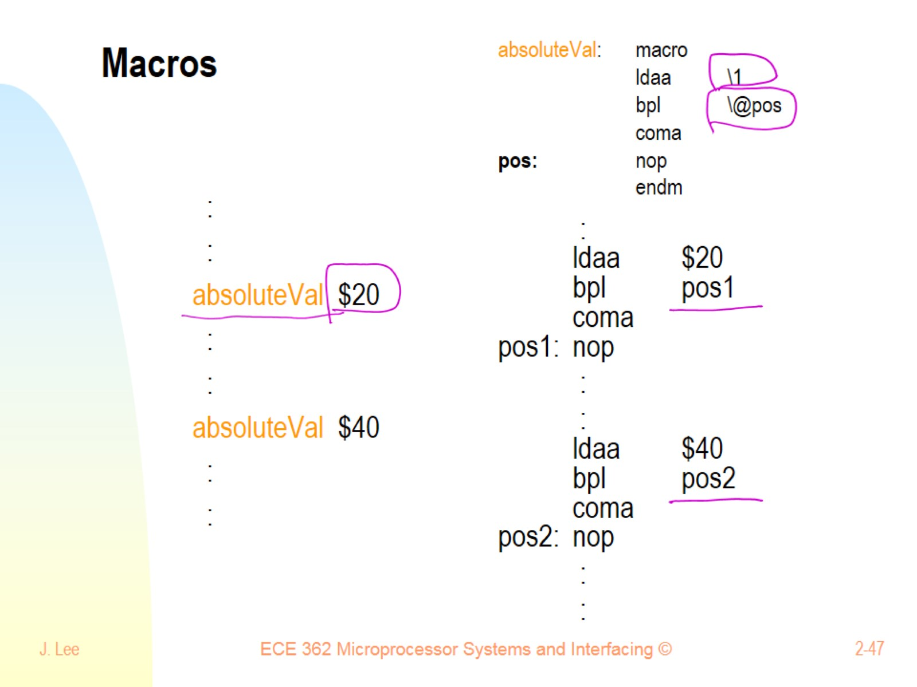
Macros

Slide 48
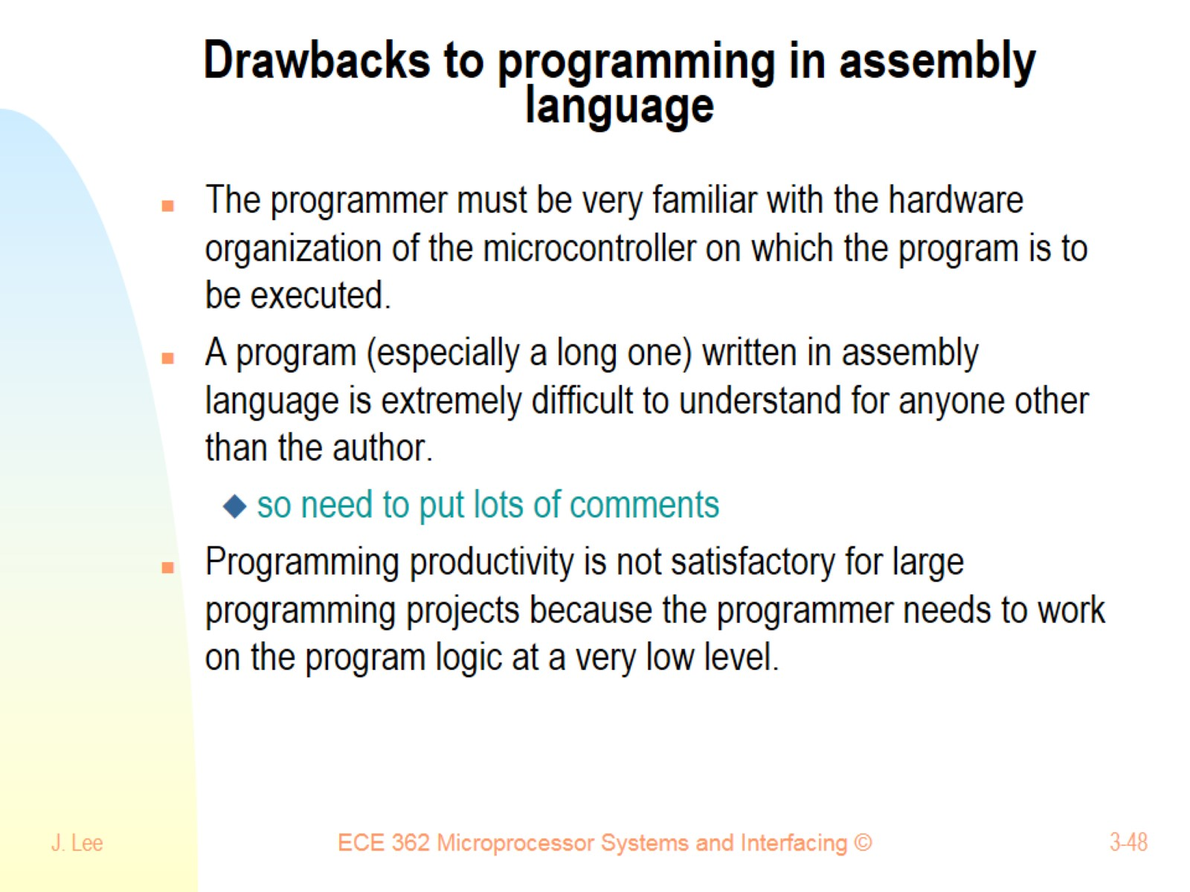
Drawbacks to programming in assembly language

Slide 49
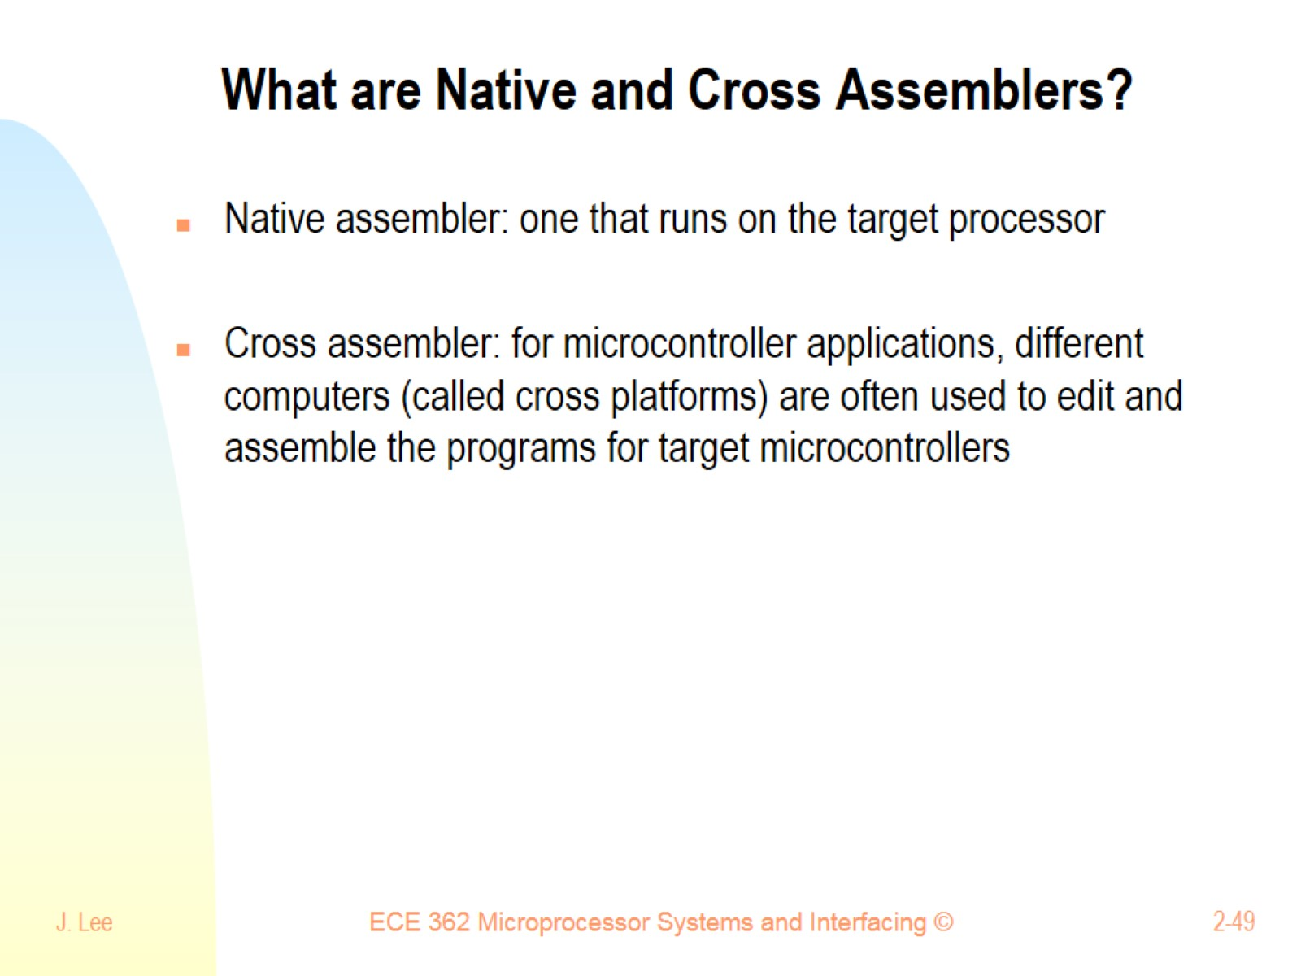
What are Native and Cross Assemblers?

Slide 50
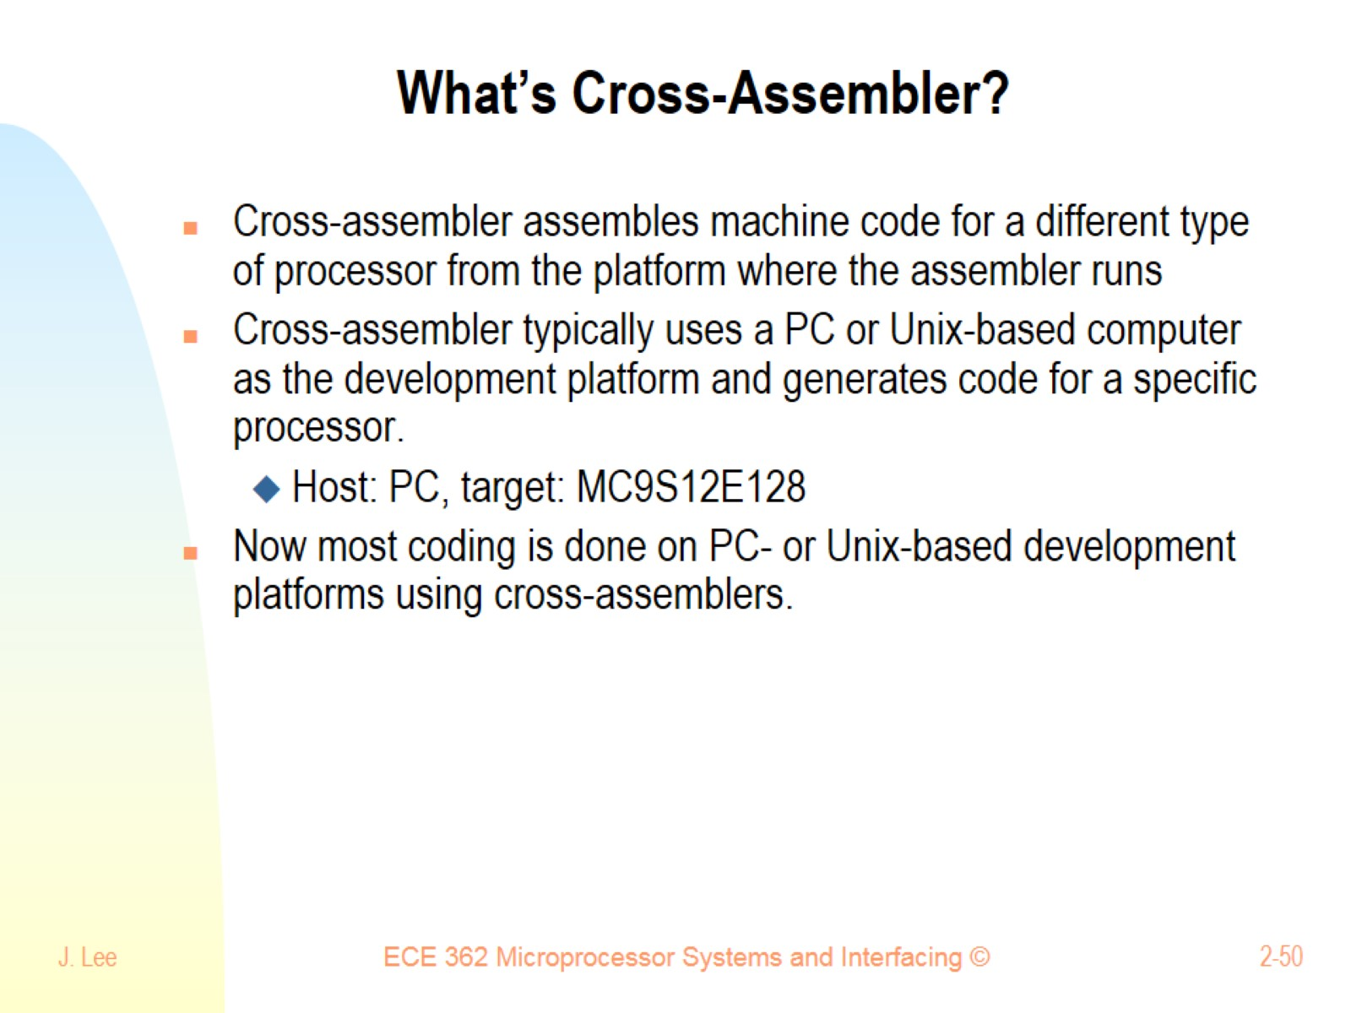
What’s Cross-Assembler?

Slide 51


Slide 52

Input/Output (I/O) Ports

Slide 53

Data Direction Register

Slide 54

I/O Port Addresses

